Slide 1

How to develop and use a
My Support Plan
Jennifer Firth & Nicola Shaw
Early Years Area SENDCO's
Kirklees Early Years SEN Support (EYSEN)

Slide 2

Kirklees and Consistency
The My Support Plan (MSP) has been in place in Kirklees since the introduction of the SEND reforms in September 2014.
Schools and settings across Kirklees are required to use this format. This enables consistency for each child and their family and professionals through all transitions

Slide 3
Why a My Support Plan (MSP)
A My Support Plan is for those children who, after collecting evidence of need, need a more targeted approach to reach their outcomes beyond Quality First Teaching.
Kirklees vision for children with special educational needs and disabilities is the same as for all children and young people that they achieve well in their early years, at school and in college, and lead happy and fulfilled lives.
…….the aspirations for children and young people will be raised through an increased focus on life outcomes.

Slide 4
Aspirations
It is important throughout assessing, planning, delivering and reviewing the My Support Plan that high aspirations for the child take the lead.
The Code of Practice 2014 says -
1.39 ‘With high aspirations, and the right support, the vast majority of children and young people can go on to achieve successful long-term outcomes in adult life.’
8.10 ‘Children and young people’s aspirations and needs will not only vary according to individual circumstances but will change over time as they get older and approach adult life.’
8.11 ‘Planning must be centered around the individual and explore the child or young person’s aspirations and abilities, what they want to be able to do when they leave post-16 education or training and the support, they need to achieve their ambition.’

Slide 5




Golden thread
1.The Golden Thread
There should be a golden thread directly from the aspirations to the provision and this is achieved by thinking about outcomes as steps on the journey towards the aspirations.

Slide 6
What should it include
Section 1: About me my profile, my story, my family and my parents/carers views
Section 2: My special educational needs
Section 3: My health needs which relate to my special educational needs
Section 4: My social care needs which relate to my special educational needs
Section 5: Outcomes and provision
Section 6: Reviewing My Support Plan
Section 7: Appendices

Slide 7
Who should be involved?
The Child
Parents/ Carers
Setting
Outside educational agencies i.e. EYSEN, CCI
Health Professionals involved with the child i.e. Speech and Language, Physiotherapist, Occupational Therapist etc......
Social Care Professionals involved with the family i.e. Social Worker, Family Support Worker etc.......
Who should be involved?

Slide 8
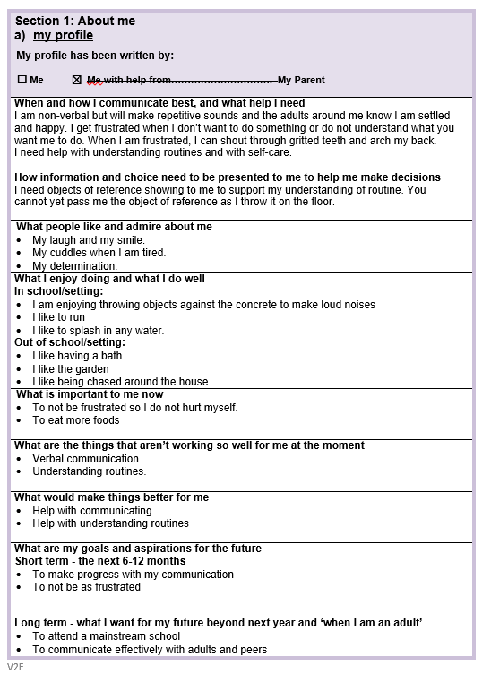
Section 1 – My profile
Section 1 provides a framework to record; ​
•What is important to the child, young person and their family and how best to support them.
• Contributions from the child if they are old enough and able to contribute, if not then it is important that the parent/ carers views are visible in this section. They become the child's voice. ​
So the system needs to support children, young people and their parents to have high aspirations for the future. We must seek to raise aspirations by not only thinking about what is possible now but thinking creatively about what could be possible in the future.
Aspirations must be challenging

Slide 9
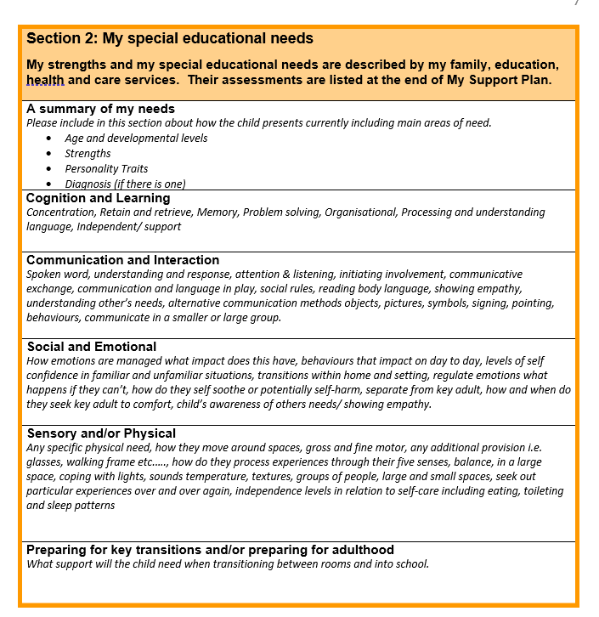
Section 2 – My Special Education Needs
6.28 ‘Special educational needs are linked to the 4 broad areas of need as outlined in the Code of Practice. Cognition and learning, Communication and interaction, Social, emotional and mental health and Sensory and/or physical.’

Slide 10
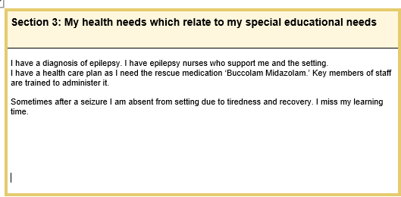
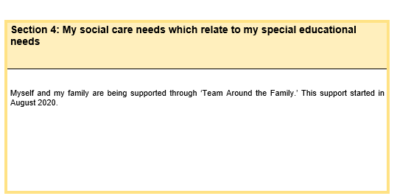
Section 3 & 4– My Health and Social Care Needs
Sometimes a child or young person has health needs that relate to their SEN or social care needs that relate to their SEN and as such have an impact on their learning progress. This is where a collaborative approach across services is particularly important .
Sharing outcomes across Education, Health and Social Care
In order to make a positive difference towards aspirations and life outcomes, outcomes will need to be holistic i.e., where appropriate they will need to be shared between education, health and social care. Therefore, it is important to be collaborative when setting outcomes.

Slide 11
Targeting setting – Outcomes
The Code of Practice 2014 says -
9.66 ‘An outcome can be defined as the benefit or difference made to an individual as a result of an intervention. It should be personal and not expressed from a service perspective; it should be something that those involved have control and influence over, and while it does not always have to be formal or accredited, it should be specific, measurable, achievable, realistic and time bound (SMART)’
9.68 ‘Outcomes will usually set out what needs to be achieved by the end of a phase or stage of education in order to enable the child or young person to progress successfully to the next phase or stage’.

Slide 12
Remember
All Longterm Outcomes, Steps Towards Outcomes and Short-Term Outcomes must be it SMART
Specific, Measurable, Achievable, Realistic and Time bound
By week beginning 12-10-20 (6-8 weeks) Sarah will follow the object of reference for the water tray and sand tray when supported by an adult on three separate occasions.

Slide 13
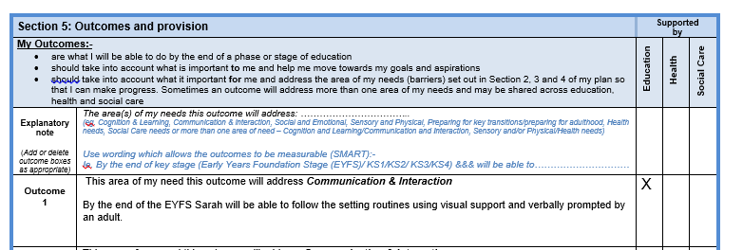
An example of a long - term outcome could be
My Support Plans usually include a range of Long-Term Outcomes that link directly to the child's identified needs.
This can depend on the child's individual needs and can cover multiple areas of need.
Cognition & learning, Communication & Interaction, Social & Emotional,
Sensory/ Physical.
Outcomes may be given to settings and providers by a range of different services; however it is essential that the child and family are at the core of the outcomes set.

Slide 14
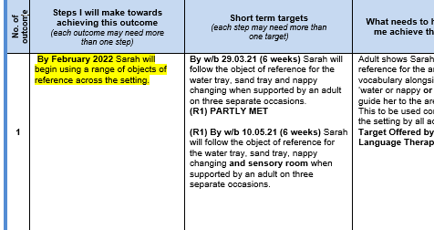
Target Setting
Steps Towards Outcomes
The Steps towards Outcome should keep the golden thread, ensuring if follows on from the short-term outcome and stays relevant for up to a year ahead.
It must also follow the same format of the long-term outcome ensuring the long-term outcome is aspirational but realistic.
E.G. of a SMART steps towards outcome below

Slide 15
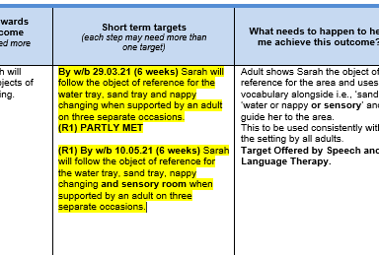
Target Setting
Shorter Term Targets
Shorter term targets are set at the level of the school or setting where the child attends.
Practitioners and Professionals working with children set shorter term targets with the parents/young person that will be reviewed and amended regularly to ensure that the individual remains on track to achieve the outcomes specified in their plan.
Regular progress monitoring
Shorter term targets should be SMART so that progress can be monitored.

Slide 16
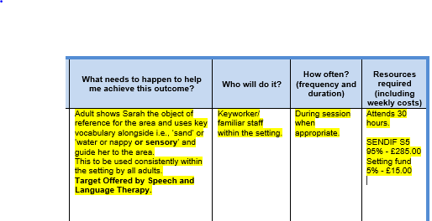
Provision
Provision is the intervention/resource that is to be provided in order to work towards attaining the outcome
The Code of Practice 2014 says - Page 16 – xvi. ‘Special educational provision is provision that is additional to or different from that made generally for other children of the same age.’

Slide 17
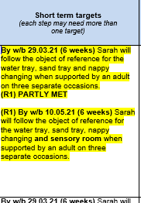
Reviewing
The Code of Practice 2014 says - Page 87 – 'The effectiveness of the support and its impact on the child's progress should be reviewed in line with the agreed date. The impact and quality of the support should be evaluated by the practitioner and the SENCO working with the child's parents and taking into account the child's views. They should agree any changes to the outcomes and support for the child in light of the child's progress and development. Parents should have clear information about the impact of their support provided and be involved in planning next steps. '
Each review for the same outcome stays within the same column. As the arrow shows, this will be where review 2 goes in 6-8 weeks' time.

Slide 18
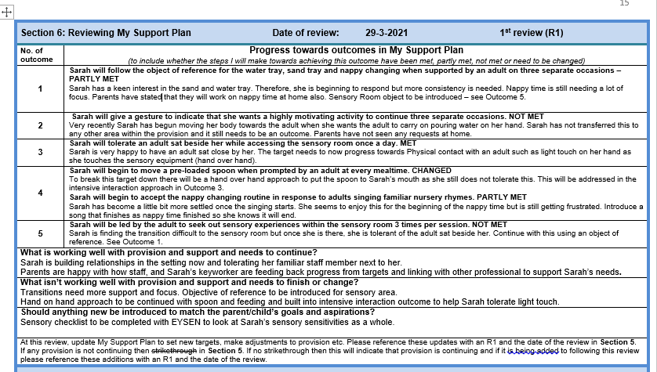
Reviewing
The Code of Practice 2014 Pg. 87 says -'This cycle of action should be revisited increasing detail and with increasing frequency, to identify the best way of securing good progress. At each stage parents should be engaged with the setting, contributing their insights to assessments and planning, intended outcomes should be shared with parents and reviewed with them, along with action taken by the setting, at agreed times.

Slide 19
Summary
Remember to involve parents/ families and other professionals to support the MSP process.
Remember MSP is a working document- this means it can be changed as needed.
Remember all targets need to be SMART – SPECIFIC, MEASURABLE, ACHIEVABLE, REALISTIC AND TIME BOUND.
The reviewing process needs to be done in a timely manner – enough time to allow progress towards the targets but not too long that they can't be altered to meet need. An example of this is reviews every 6-8 weeks.

Slide 20
Further Support
Early Years SEN Support ( EYSEN)
3rd Floor Empire House
Old Wakefield Road
Dewsbury
WF12 8DJ
01924 483744
Dewsbury.Psychology@kirklees.gov.uk

