Slide 1

Welcome to SENCoNet
Spring 2015

Slide 2
Time slot | Item | Delivery
8:45 – 9:00 | Networking
9:00 – 9:05 | Updates | Sarah Grant
9:05 – 9:15 | Local Offer | Laura Hardcastle and Holly Graley
9:15 – 9:35 | Introduction to Area Cluster leads | Anna Garfitt and Oluchi Yusuf
9:35 – 9:55 | The EHCP team updates | Zoe Gatland
9:55 – 10:15 | The Woodley offer | Suzanne Taylor
10:15 – 10:30 | Break
10:30 – 10:45 | SEND youth forum | Kay Parry and Sarah Grant
10:45– 11:05 | Inclusive schools | Debbie Kelly
11:05 – 11:30 | Table discussions on inclusive schools | All

Slide 3
Neurodevelopment Pathway
We have recently changed the way that we accept a telephone referral from a SENCo . We now firstly ask for a consent form to be signed by the parents and the child if 14 or over, then returned to us via email and then a call can be made to request a telephone consultation appointment. This then allows our team to access a child’s full medical record and helps make decisions about the correct course of action for the child.
This became mandatory in January 2025

Slide 4
The SENDACT team will henceforth be called the EHCP team to help to clarify its role

Slide 5

The Local Offer

Slide 6
https://forms.office.com/e/4ZZwLfdUJf

Slide 7
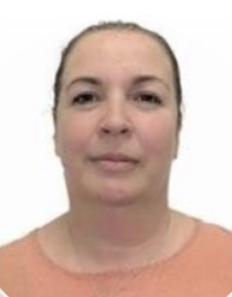
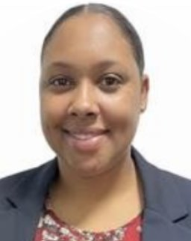
Cluster Area Lead
Anna Garfitt
Background: Primary school SENCO
Cluster Area Lead
Oluchi Yusuf
Background: Secondary school SENCO
Cluster Area Lead Role
Anna – Batley, Spen and The Valleys (Area A and D, clusters 1, 2, 3, 6, 17, 4+11, 7, 12, 13)
Oluchi – Dewsbury, Mirfield and Huddersfield (Areas B and C, clusters 5, 8, 9, 10, 14, 15, 16, 18)
Provide support for Cluster Leads
Share developments & updates
Co-ordinate the delivery of cluster working
Strategic development of cluster working
Link between clusters and other agencies within the LA
Notes:
Focus on recent work as SENDCos

Slide 8
Clusters
Why do this?
Because we’re ambitious for children and families in Kirklees
There’s opportunity for all of us to support each other in better ways
National and local context means its right to look at how we can do things differently

Slide 9
Clusters
Why do this ?
Because we’re ambitious for children and families in Kirklees
There’s opportunity for all of us to support each other in better ways
National and local context means its right to look at how we can do things differently
Principles
Include …
  Commitment to equity & positive outcomes across Kirklees
  Improves capacity of schools
  Willingness to share good practice & learn from others
Supports greater consistency and quality in schools
Supports early intervention
Share good practice and learn from others
Notes:
SENCO network/community – advice from specialist LA colleagues.

Slide 10
Clusters
Why do this?
Because we’re ambitious for children and families in Kirklees
There’s opportunity for all of us to support each other in better ways
National and local context means its right to look at how we can do things differently
Principles
Include …
  Commitment to equity & positive outcomes across Kirklees
  Improves capacity of schools
  Willingness to share good practice & learn from others
Supports greater consistency and quality in schools
Supports early intervention
Share good practice and learn from others
Evolution not Revolution
Fresh approach given the current SEND context nationally
Increased collaboration
Developing better understanding of needs
Shared understanding of local priorities
Challenges
Notes:
Recognise that cannot be business as usual.

Slide 11
Clusters
Why do this?
Because we’re ambitious for children and families in Kirklees
There’s opportunity for all of us to support each other in better ways
National and local context means its right to look at how we can do things differently
Principles
Include …
  Commitment to equity & positive outcomes across Kirklees
  Improves capacity of schools
  Willingness to share good practice & learn from others
Supports greater consistency and quality in schools
Supports early intervention
Share good practice and learn from others
What next?
Build on initial successes
Work collaboratively to meet the needs of children
Support each other, share good practice and learn from each other
Develop fresh and creative approaches to meet need through efficient use of all funding available
Work together to recognise the challenges and find solutions
Evolution not Revolution
Fresh approach given the current SEND context nationally
Increased collaboration
Developing better understanding of needs
Shared understanding of local priorities
Challenges

Slide 12
FAQs
Is the local authority taking money (e.g. EHCP funding) away from schools?
Is it the responsibility of the cluster to determine whether an EHC Needs Assessment is needed, if an EHC plan is issued or what funding will be allocated to an EHCP?
Is the new cluster model legal?
Can children and young people who attend a Kirklees school but live in a neighbouring local authority access support through the cluster?
What happens when a child moves schools? Does the process need to start again or is there a way we can transfer?
What is the benefit to my school if we do not have any cases to bring?

Slide 13

SENDACT/EHCP Team
January 2025

Slide 14
Updates
Name change from SENDACT to EHCP Team
New structure
Placed based working
Quality Assurance & Compliance
New system implementation
Redesign of decision making groups

Slide 15
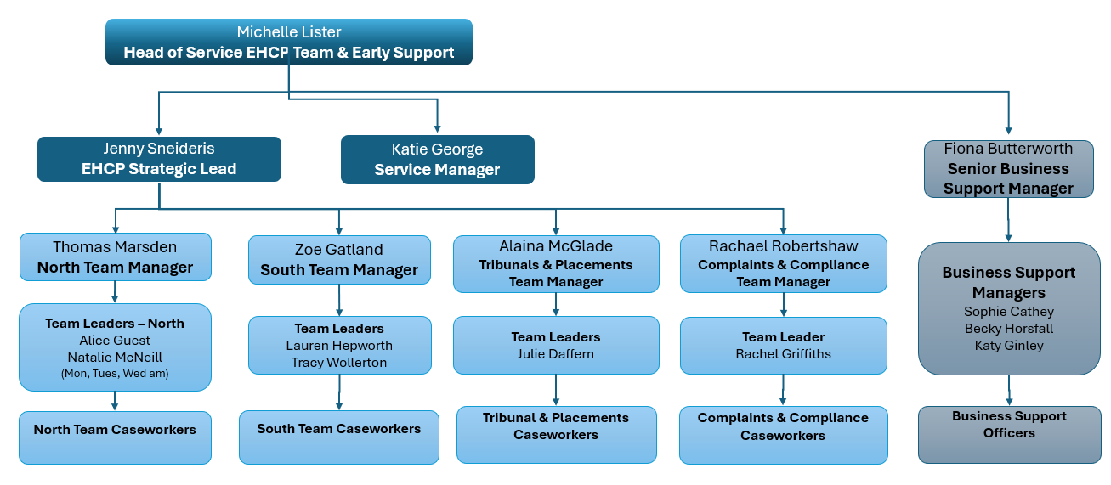
EHCP Team Structure

Slide 16
Data
Currently 4812 active EHCPs
100% decisions made within statutory timescales
128 plans issued in October 2024 – biggest month
17 assessments over 30 weeks - reduction from over 100
0 assessments over 52 weeks – reduction from 184 in July
2024 end of year 20 week compliance is 23% - was 0% in May
Currently 109 Tribunals

Slide 17
What's Next
Embed the new ways of working
Liquid Logic Partners portal
Review of new structure
Quality Assurance tool
Annual reviews
Improve Communication

Slide 18


SENDCO Net March 2025

Slide 19
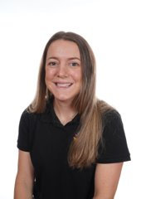
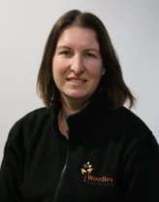

Kirklees AET Hub: Training Team
Suzi Taylor
Assistant Headteacher
Catie Rayner
Lead AET Trainer

Slide 20
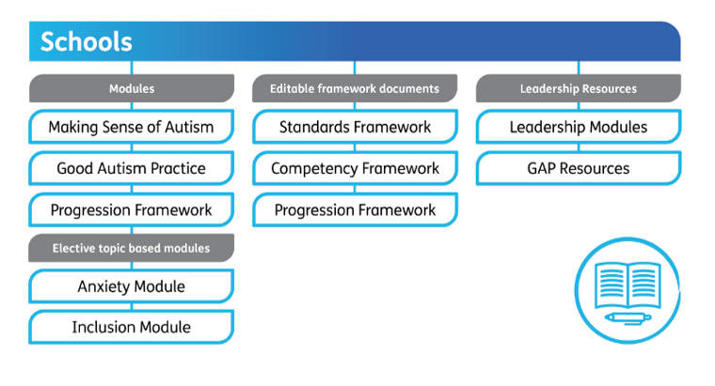

Slide 21

Professional's Evenings
Termly after school
Mini training sessions on specific autism topics
Resource sharing
School Tour
Networking

Slide 22

Outreach and Training Team
Contact: training@woodleyschool.org.uk
To sign up to our mailing list for training and professionals evening scan our QR code:

Slide 23


Core Purpose, Vision and Values
Notes:
Woodley School and College is a through school that teaches autistic young people from EYFS through to 19 years old.
We believe that the most important elements to develop and improve the Quality of Life for our students is their Communication, Independence and Achievement. These Core Purposes form the learning foundation for everything we do.

Slide 24
Woodley School Criteria (5-16)
Pupils will have an EHCP and an autism diagnosis.
Pupils may also meet some or all of the following criteria:
Difficulties with self-management and self-regulation
Difficulty with social interactions
High levels of anxiety
Inflexibility and rigidity of thought
Difficulties with sensory processing
Notes:
Pupils who attend Woodly have an EHCP with their main need identified as being consistent with a diagnosis of Autism with a high level of need. It is likely that pupils also have additional needs associated with the diagnosis. Epilepsy, mental health, ADHD, motor co ordination and specific language impairment alongside sensory processing difficulties.

Slide 25
What to do if you have parents requesting specialist placement
If you are suggesting Woodley to parents, have you been?
Parents need to attend one of our open evenings
Does the child have a diagnosis of autism?
Is autism their primary need?
Is the child working at least 18months in cognition?
Does the child understand symbols or objects of reference?
Does the child show understanding of structure and routine?

Slide 26


Any Questions?

Slide 27



Hearing the voices of children and young people who experience SEND...a proposal
“...disabled children and young people have fewer opportunities to participate in decision-making than their non-disabled peers.”
CDC (2025)
Our Voice is the Kirklees Children and Young People’s Participation Project. Contact us at ourvoice@kirklees.gov.uk

Slide 28
The Voice of Children and Young People-SEND
Missing: Wider structure and
network
Today’s proposal for your ideas
and development
SEND/SEMH New builds,
Short Breaks Commissioning
Service developments (KKIM)
Consultations-Care and Respite/ Transport
Ad-Hoc sessions for specific
projects
Relational groups
(FOC) in Specialist, Short Break
and Adapted Provision
We have established groups in
1 Specialist
1 Satellite
1 ARP
1 Post-16
1 mainstream
and links with 4 other
Would you like one in your school?
Regional Youth Alliance/ National
Projects
Developmental pathway
for young people who want to ‘do more’
Space, Voice, Audience & Influence Lundy’s 2014 Model of Participation

Slide 29

Could we work together?
SENCO’s/Provisions recruit 2-4 young people as reps.
OVT send an engagement pack to the reps so they can work with other yp in the provision. These would arrive 4-6 weeks before the meeting. There would be a meeting per term.
OVT arrange and facilitate a TEAMS meeting with all reps (Reps to be supported by the provision) to share their info and discuss the ask/theme. Young people can also raise their own themes.
Meetings will be recorded in picture minutes summarising the number of attendees, provisions and actions to take to the people who can shape/influence. Feedback any outcomes or changes would arrive in the next engagement pack. This would evidence pupil voice for OFSTED and provide intel for your provision/ Decision Makers/ Regional and National Work.
At the end of the year, we’ve 3 lots of minutes to pull into an overall engagement report, which can be shared across the network. We will celebrate the young people and build the forum.

Slide 30

Want to be involved?
The initial session will be in June 2025 with 10 schools as a pilot, it’s focus will be on year 6 transition.
Overall sessions will begin in Oct 2025.

Slide 31

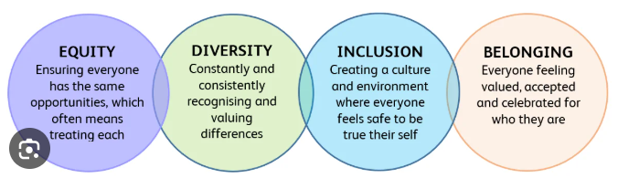
Inclusion
Debbie Kelly & Sally Tunnacliffe
Beaumont Primary Academy

Slide 32


Inclusion is the pre-cursor to belonging

Slide 33
Credibility- Why is this important to us ?
690 pupils, 94 staff
29% of pupils have English as an additional language, (although in reality this figure is higher than stated on admissions)
There are at least 24 languages spoken by families within our community.
87% of students are from ethnic minority backgrounds,33% FSM (229) ,31% live in the 0-10% of most deprived area nationally ,
34 % live in the 10% to 20% of most deprived areas nationally, 16% live in the 20-30% of most deprived areas nationally
36 EHCPs 24 IAPDRs, 12 SEMH S2SR plans, 3 PEEP plans, 23 on waiting list for NDP pathway, 111 SEN Support
In Spring 1, we had 178 causes for concern logged on cpoms, 7 referrals to social care for physical abuse, neglect and domestic abuse/servitude/modern day slavery
In the last 18 months we have worked with children who within very close family have experienced suicide, attempted murder and manslaughter convictions, substance and alcohol addiction, serious physical and emotional abuse and neglect, serious parent mental health. We have 8 looked after children, 7 of whom have been taken into care following disclosures in school. We have 11 children with a parent in prison. We have an unaccompanied asylum seeker. Our SEMH need is significant and our ordinarily available offer is integral to our inclusive school community. We opened an SEMH provision in September 2023.
OFSTED December 2024
Recognised the exceptional high standards of inclusion and provision for pupils with SEND across all complexities.

Slide 34
Broken system; frustration
Globally
Nationally
Locally
Too many children rejected/misunderstood by mainstream
Too many SEND (EHCP) children attend mainstream out of area
Too many children pushed out to specialist places because of missed opportunities in early mainstream – unmet needs made
more challenging by poor response by school staff
Increasing children are experiencing trauma caused by education
professionals and the unbending systems
Turning children away from their communities
Parents feeling unsupported, judged and unwanted
As heads and SENCOs, we are part of the problem and much of the solution.

Slide 35
Money or culture and ethos
No amount of money will change culture and ethos
How confident are you in the strength of your culture and ethos faced with the increasing challenge of inclusion ?
Our cohorts are harder and more complex than ever – this is only going to increase. We must be prepared. Rejecting children is not the answer…

Slide 36
So how do we do it ?
So how do we work with bravery; how do we build an inclusive community ? How do we improve our culture and ethos? Improve our SEND offer?
Can we stop rejecting children from their own communities?
This child is someone’s son/daughter/sister /brother
Look after staff, simplify systems,
Whole staff training and commitment – developing a culture and ethos particularly around SEMH- high quality PD
Adapting expectations but maintaining clear boundaries
Risk assessments which are clear
Strength of response by all adults being consistent- emotion coaching, PACE
Not being dismissive of anxiety/emotional based response and trauma
Address staff fears head on- SLT involvement
How do we balance the demand of outcome targets with the need for inclusion.

Slide 37


Slide 38

A square peg in a round hole will eventually become damaged unless we reshape the hole - it can be done with the right culture and ethos
He will not beat us
Practicalities
Personalised timetables- how long realistically can a child be in the classroom
How well do you really know the likes/dislikes/triggers/motivators
Tips and tricks
Include peers/explain/myth bust ‘it’s not fair’
Changing the narrative
Change of face
Praising the minutiae positives
Common language and scripts, common language
Don’t panic

Slide 39
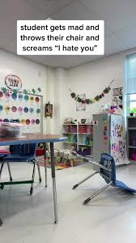


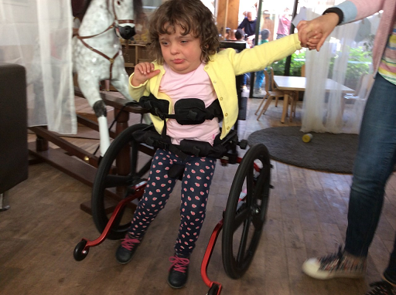
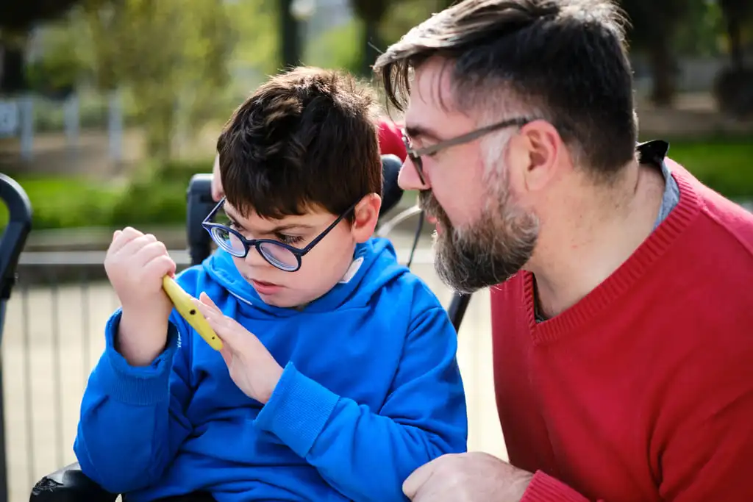
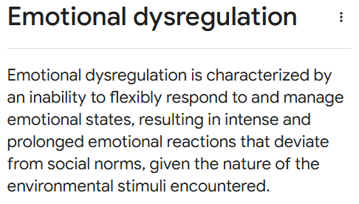
Barriers
Fear and inexperience
Standards and inclusion
Too much language
Clear plans- don’t interfere if someone else is dealing- is this clearly communicated
Check on safety
Code words to support
Don’t talk about the child in front of the child
We have to stop pushing children out of our school communities
How long is a piece of string ?

Slide 40



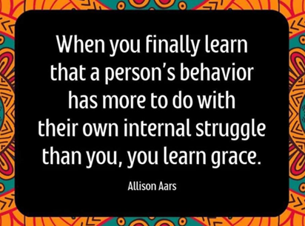
We cannot change the children coming through the system. We are not going to receive the millions we may think will help. The answer lies in adapting and changing to the educational landscape we work in. None of us have all of the answers but a determination to find ways is a good starting point. We are all only as good as our lowest performing school.
See the child - really see the child
respond with kindness, care, compassion and explore more ways to meet need and support

Slide 41

Thank you

