Slide 1

Welcome to SENCoNet
Spring 2026

Slide 2

Dingley’s Promise – last chance to access £500 worth of FREE high-quality training for Early Years staff!
The Comic Relief funded project ends in June of this year and FREE access to the training resources will cease. Sign up TODAY on the Dingley’s website to download training manuals and resources!
Also – a big thank you to everyone who has already signed up and completed the training. We now have 59 settings in Kirklees who have achieved the Dingley’s Promise Mark of Achievement showing their commitment to Inclusive practice and 79 new learners have signed up since January – keep up the great work!

Slide 3

Emotionally Based School Avoidance (EBSA)
& ways schools can help
Dr Greta Kosters Senior Educational Psychologist
Kirklees Educational Psychology Team
Applying psychology thoughtfully – Acting with integrity – Making a difference
Placing children and families at the heart of what we do

Slide 4
Aims
  Outline some key concepts of Emotionally Based School Avoidance (EBSA)
  Frameworks & Strategies
  Signpost to resources

Slide 5
What is Emotionally Based School Absence/Avoidance (EBSA)?
‘Reduced attendance or non-attendance at school where the avoidance is driven by emotional distress’ (Lester and Michelsomn, 2024)
EBSA arises from a complex interplay between predisposing factors and a precipitating event or change in the child’s circumstances. It is not a condition/psychiatric disorder but often co-occurs with anxiety and/or mood disorders
Even when children do manage to attend school, their anxiety may impair access to learning
Commonly occurs at educational transitions (high risk period is when transitioning from primary to secondary and research also suggests the first 2 years following transition to secondary)
Research tells us that children with EBSA often don’t feel listened to and understood

Slide 6
Spectrum of EBSA
Attendance with anxiety
Attendance with avoidance behaviour
Attendance with lateness/ avoidance behaviour
Periodic absences
Repeated absences
Complete absence for a period
Complete absence for an extended period
Adapted from Kearney, C., & Albano, A. (2018)

Slide 7
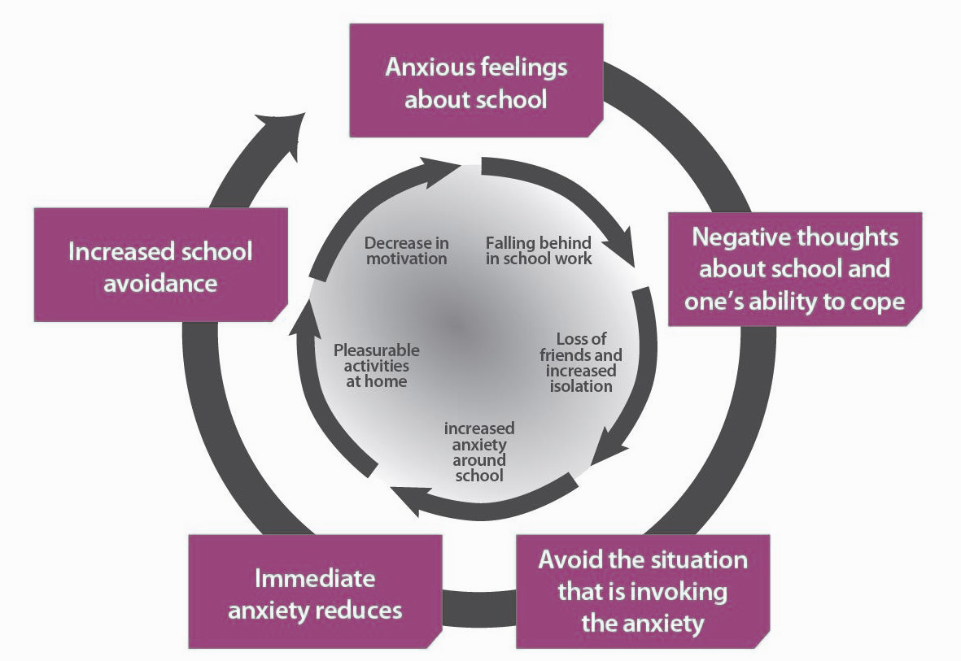
Anxiety and Emotionally Based School Avoidance
Diagram showing the initial anxiety causing the non-attendance and the secondary maintenance factors.

Slide 8
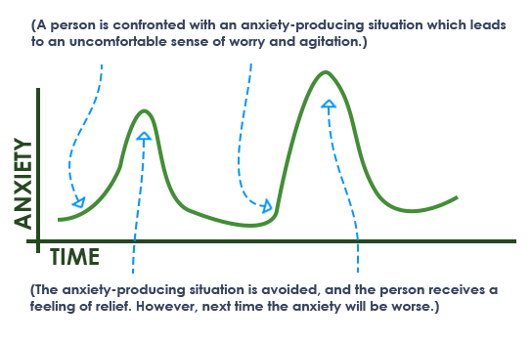
Anxiety Curve
The Anxiety Curve

Slide 9
Function Based Approach (Kearney and Silverman, 1990)
To avoid uncomfortable feelings brought on by attending school, such as feelings of anxiety or low mood. | 2. To avoid situations that might be stressful, such as academic demands, social pressures and/or aspects of the school environment.
3. To reduce separation anxiety or to gain attention and connection from significant others, such as parents or other family members. | 4.To engage in rewarding experiences outside of school, such as going shopping or playing computer games during school time.

Slide 10
4 STEPS
Step 1
Define the behaviour
Step 2
Identify the function behind the behaviour (SRAS-R scale)
SRAS-R scale (school refusal assessment scale)
Step 3
Match intervention to function behind the behaviour
Step 4
Monitor effectiveness of the intervention

Slide 11


“School refusal occurs when stress exceeds support, when risks are greater than resilience and when ‘pull’ factors that promote school non-attendance overcome the ‘push’ factors that encourage attendance”
(Thambirajah et al, 2008 p. 33)
Model to Help Explore & Understand Student EBSA
PUSH
(towards)
PULL
(away)

Slide 12
Activity: decide whether the item is a push or pull factor
PUSH
(towards school)
PULL
(away from school)

Slide 13
Risk Factors
School Factors | Family Factors | Child Factors
Bullying/Perceived Bullying | Separation/Divorce | Neurodiversity/ neurodivergence
Academic difficulties/Academic pressure | Bereavement and loss | Fear of failure/poor self confidence
Sensory environment | Parental health/mental health | Trauma
Transitions | Conflict within the home | Physical illness
Tests/Exams | Being the youngest child | Age/puberty/sensory differences
Peer or staff relationships | High levels of stress within the home/substance issues | Learning differences-unmet need
Transport or journey to school | Young carer | Separation anxiety

Slide 14

Protective Factors
Ambition, aspiration and motivation
Confidence, self-esteem, self-efficacy, value in themselves
Feelings of safety, security and a sense of belonging
Positive and successful experiences in school
Positive relationships with peers or staff
Feeling listened to and understood
Understanding relationship between thoughts, feelings and behaviour
Partnership between school, family and external professionals
Flexibility of school approaches used, linked to listening to the voice of the child

Slide 15
Masking and Emotionally Based School Absence
Rising anxiety (negative thoughts/feelings about school experience)
Avoidance
Decrease in painful thoughts/feelings. Powerful sense of relief
Masking at school
(hides their anxiety-confusion, or sensory discomfort to blend in or avoid criticism
Why masking leads to EBSA:
Energy depletion: constantly performing socially or suppressing natural responses drains mental and physical energy
Unmet needs because the adults think the child is coping and so may not offer support or adjustments
Sensory or social overload builds day by day
Masking distress means child appears fine at school: calm, quiet, compliant but underneath the child is feeling intense anxiety, social or sensory overload. Because the child supresses their true feelings and needs, adults may not realise the child is struggling until the distress is so high that it reaches breaking point

Slide 16

‘Teach me about masking’ (NeuroWild)

Slide 17

What can we do?? Levels of Intervention
Level 3: e.g. young person finding it hard to leave the house. May not have attended school for many months.
Level 2: Recent (last few months) intermittent attendance, complete non-attendance and emotional needs apparent.
Level 1: Early signs of school absence,, lateness, separation problems, emotional upset, big/disproportionate reaction to ‘small’ things
Consider involvement of other services/agencies, KKIM, Clusters, Early Help
Assess, Plan, Do, Review
School targeted intervention – e.g ELSA, circle of friends
Universal approaches (whole school)
Getting the basics right!!

Slide 18
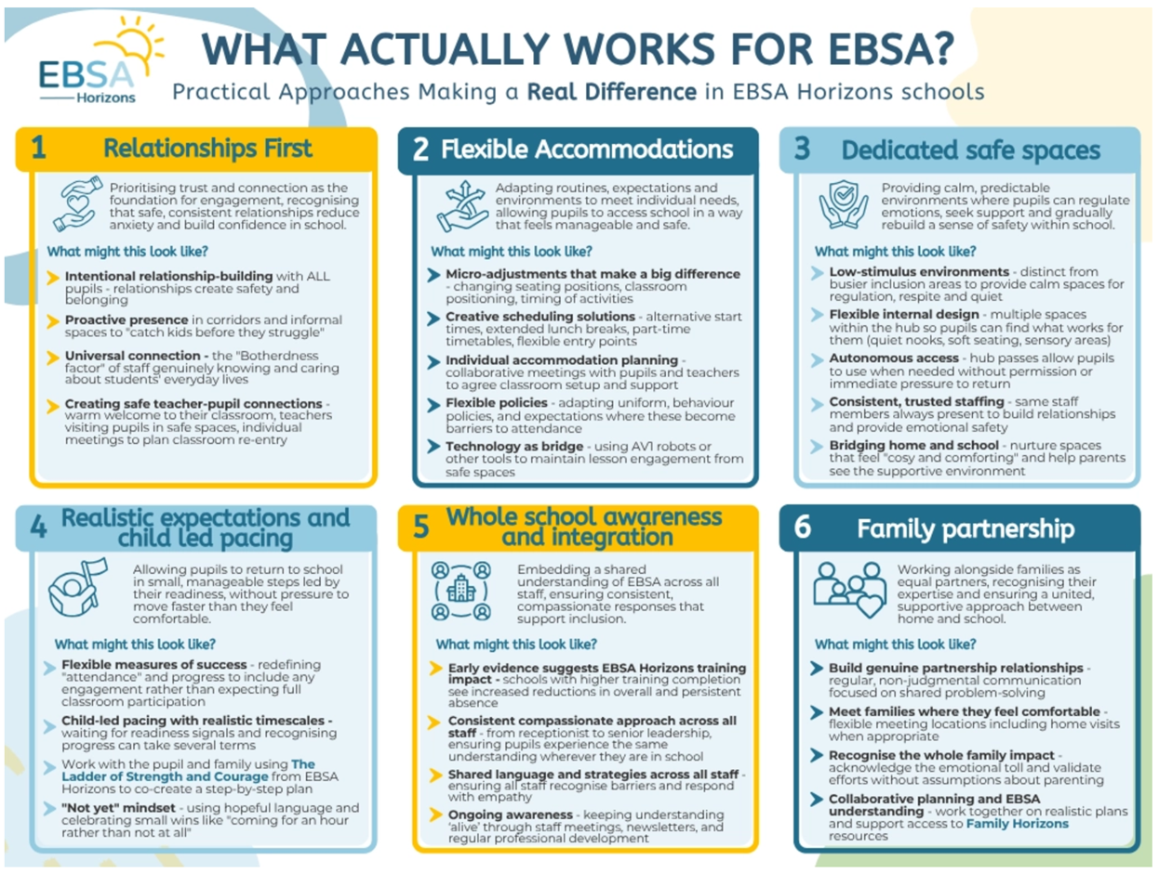

Slide 19
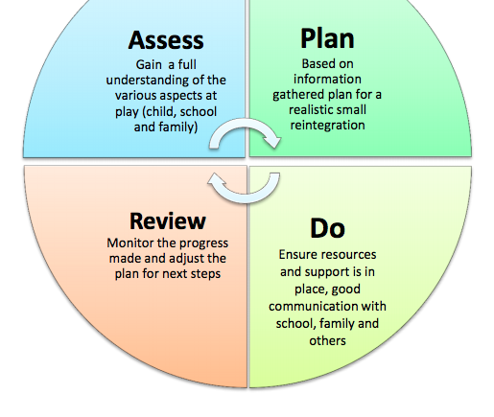
A Plan for Supporting EBSA
Personalised – seek views of child, family, school staff to inform planning next steps
Realistic - small, gradual, achievable steps forward, earn from but don't be deterred by setbacks
Relationship-based – both child and parent / carer need a key person in school and regular contact scheduled
Supportive – help the young person to manage their anxiety
Flexible – school systems will need to bend, also be prepared for ups and downs!
Consider sensory differences
Positive – avoid punitive approaches and communicate belief in the young person

Slide 20
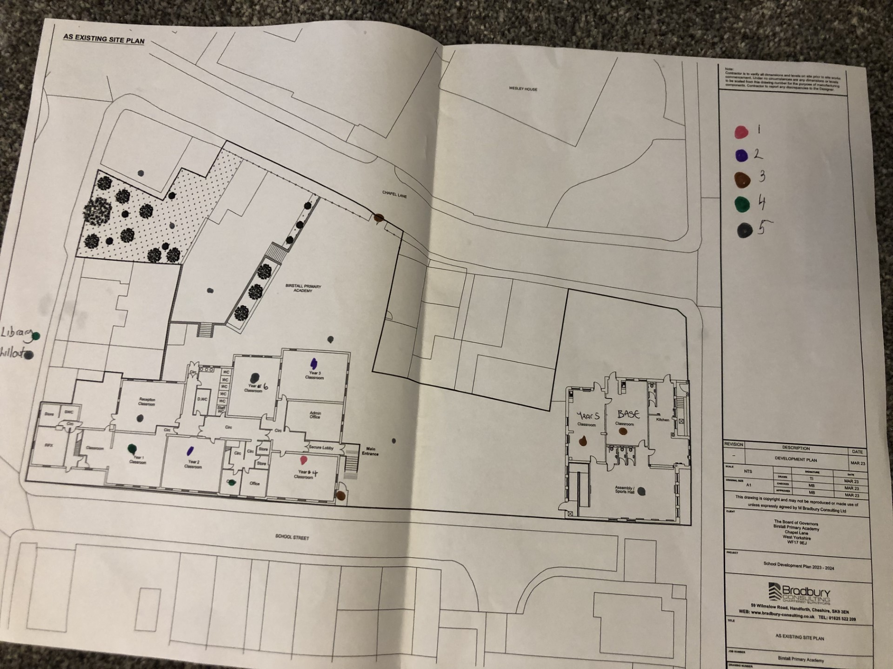
Helped to identify places of comfort and worry.
Feelings Map

Slide 21
Ideal School/Classroom

Slide 22
Scaling

Slide 23
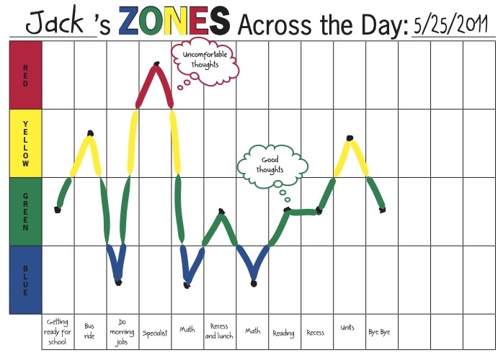
Timetable Review – provision review -

Slide 24

Developing Skills: A gradual approach
Specific measurable goal at top – meaningful to the child – CHILD LED
What young person can do now at the bottom
Break steps down (can change these as go along)
Work up steps one at a time – stay on each step until very comfortable on it – be led by the young person
If problems –praise effort and consider putting in a smaller step
Frequent practice is key!

Slide 25
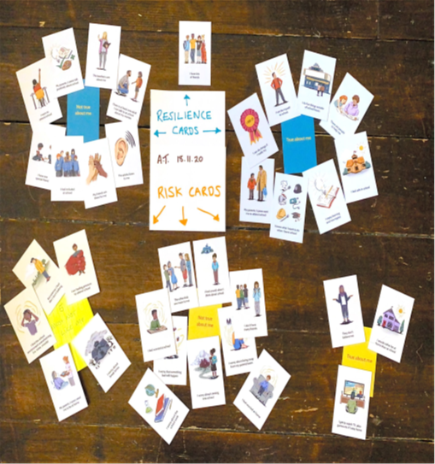

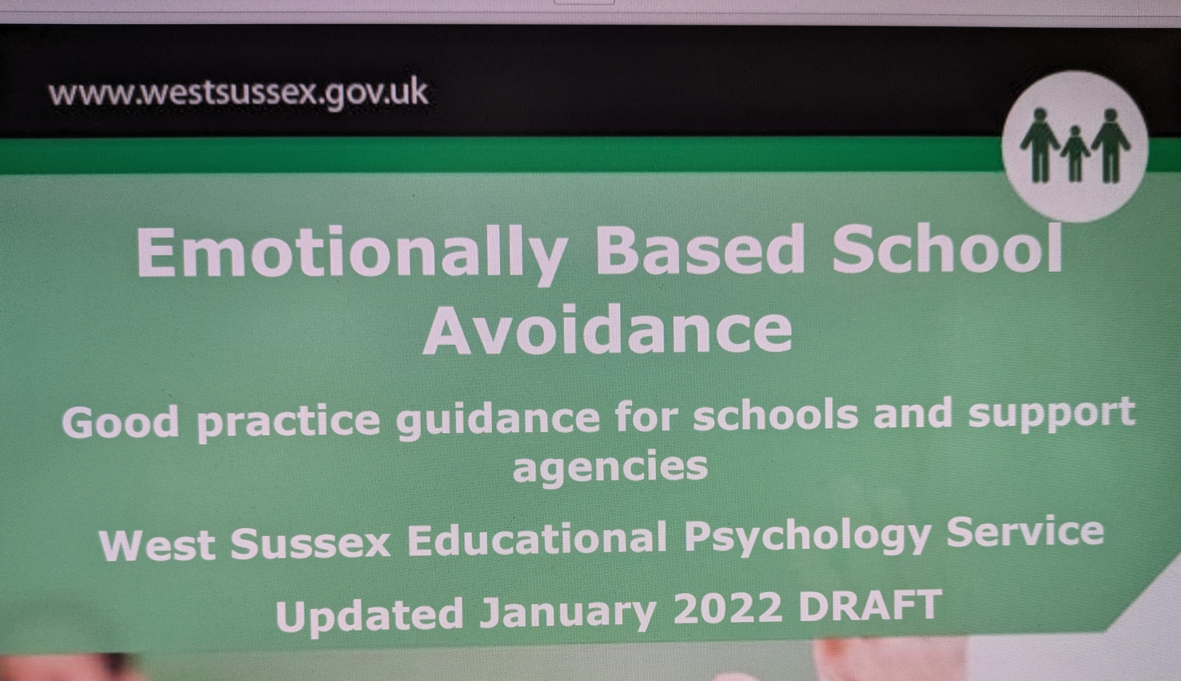
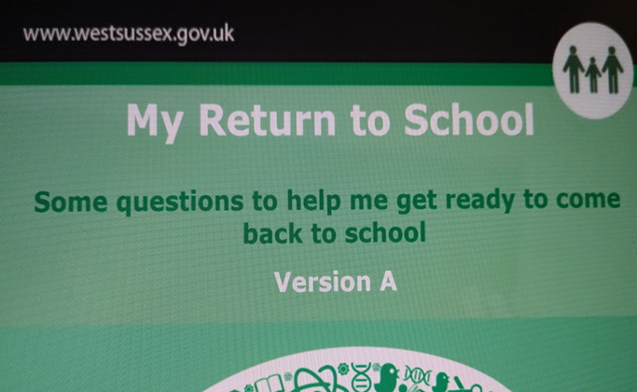
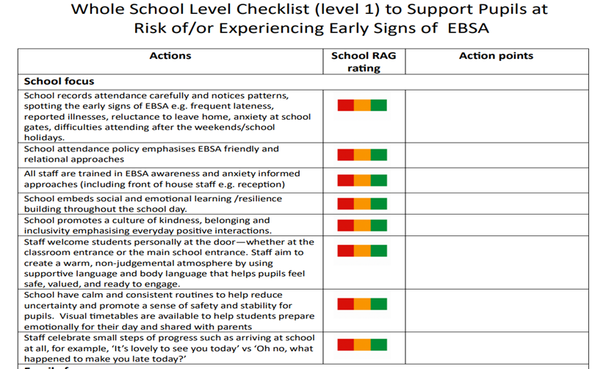
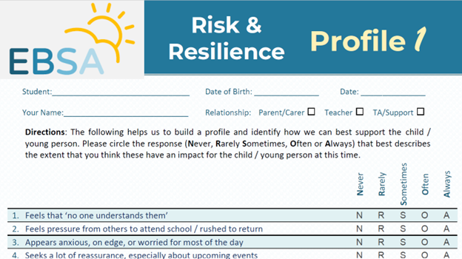
Reading & Resources
School Wellbeing Risk and Resilience Card Set (schoolwellbeingcards.co.uk)

Slide 26
Resources/Readings
Collins-Donnelly, K. Starving the Anxiety Gremlin: A Cognitive Behavioural Therapy Workbook on Anxiety Management for Young People. Book series.
EdPsychEd | EBSA Horizons | Educational Psychology Online CPD Risk and resilience profiles
EBSA Horizons, The Ideal School Questions and Templates
Kirklees Educational Psychology Service Guidance on Emotionally Based School Avoidance Resources created by Educational Psychology Services: Education Psychology Resources Documents | Kirklees Business Solutions
Rae, T.(2020) Understanding and Supporting Children and Young People with Emotionally Based School Avoidance (EBSA)
West Sussex: Anxiety and EBSA (local-offer.org)

Slide 27

Local Offer ++

Slide 28
- New Local Offer Lead
- Local Offer review over the next 6 months
- New branding
-Feedback
-The Local Offer and integration into the Families Together Service

Slide 29

SENDCoNet – Feb 2026
Cluster Communities
Working together to improve outcomes for children and young people with SEND in mainstream schools

Slide 30
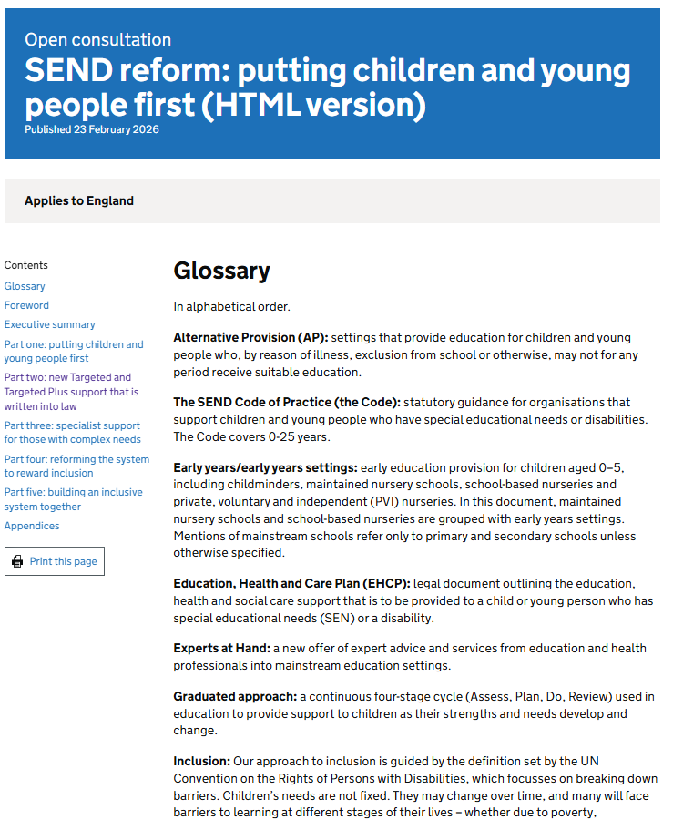
The White Paper
Expectations
Accountability
Individual Support Plans (ISPs)
  Settings will have a statutory duty to record and monitor special educational needs and provision in an Individual Support Plan (ISP) for children and young people with SEND

Slide 31

Key Legislation Governing SENCO Duties
Children and Families Act 2014
  Introduced Education, Health and Care Plans promoting holistic support for children and young people with special educational needs.
SEND Code of Practice 2015
  Provides statutory guidance on identifying and supporting SEND pupils using a graduated Assess, Plan, Do, Review approach.
Equality Act 2010
  Mandates reasonable adjustments to avoid disability discrimination and promotes inclusive strategies in schools.
Notes:
The legal framework guiding SENCO responsibilities is primarily anchored in three key pieces of legislation: the Children and Families Act 2014, the SEND Code of Practice (2015), and the Equality Act 2010. The Children and Families Act introduced Education, Health and Care Plans (EHCPs), which replaced Statements of Special Educational Needs, emphasizing a holistic approach to supporting children and young people. The SEND Code of Practice provides statutory guidance on identifying and supporting pupils with SEND, outlining the graduated approach of Assess, Plan, Do, Review. SENCOs must ensure that this process is consistently applied across the school. The Equality Act 2010 mandates reasonable adjustments to prevent discrimination against pupils with disabilities, requiring SENCOs to work closely with staff to implement inclusive strategies. These laws collectively ensure that SENCOs not only manage individual cases but also contribute to systemic change within schools. Understanding these legislative requirements is crucial for SENCOs to fulfill their obligations effectively, maintain compliance, and advocate for equitable educational opportunities for all students.

Slide 32
Other Legislation
The Special Educational Needs and Disability Regulations 2014
  Sets out details of the obligations in respect of the EHCNA assessment processes, Duties on schools in respect of SENCos, obligations in respect of the Local Offer
The Statutory Framework for the Early Years Foundation Stage
  Sets the standards for promoting the learning, development and safety of children from birth to five years in Ofsted registered settings.
Notes:
The legal framework guiding SENCO responsibilities is primarily anchored in three key pieces of legislation: the Children and Families Act 2014, the SEND Code of Practice (2015), and the Equality Act 2010. The Children and Families Act introduced Education, Health and Care Plans (EHCPs), which replaced Statements of Special Educational Needs, emphasizing a holistic approach to supporting children and young people. The SEND Code of Practice provides statutory guidance on identifying and supporting pupils with SEND, outlining the graduated approach of Assess, Plan, Do, Review. SENCOs must ensure that this process is consistently applied across the school. The Equality Act 2010 mandates reasonable adjustments to prevent discrimination against pupils with disabilities, requiring SENCOs to work closely with staff to implement inclusive strategies. These laws collectively ensure that SENCOs not only manage individual cases but also contribute to systemic change within schools. Understanding these legislative requirements is crucial for SENCOs to fulfill their obligations effectively, maintain compliance, and advocate for equitable educational opportunities for all students.

Slide 33

SEND Code of Practice
Where the text uses the word ‘must’ it refers to a statutory requirement under primary legislation, regulations or case law.
Where the text uses the word ‘should’ it means that the guidance contained in this Code must be considered and that those who must have regard to it will be expected to explain any departure from it.
The bodies that are governed by the SEND Code of Practice MUST have regard to the Code of Practice. This means that whenever they are taking decisions, they MUST give consideration to what the Code says. They cannot ignore it.
SEND_Code_of_Practice_January_2015.pdf

Slide 34

Special Educational Needs & Disability
Who has a Special Educational Need?
Who has a disability?
Who has SEN and a disability?
How do you know?
What does the legislation say?

Slide 35
When a child or young person has special educational needs
Section 20 - Children and Families Act 2014
(1)A child or young person has special educational needs if he or she has a learning difficulty or disability which calls for special educational provision to be made for him or her.
(2)A child of compulsory school age or a young person has a learning difficulty or disability if he or she—
(a)has a significantly greater difficulty in learning than the majority of others of the same age, or
(b)has a disability which prevents or hinders him or her from making use of facilities of a kind generally provided for others of the same age in mainstream schools or mainstream post-16 institutions.

Slide 36
When a child or young person has a disability
Section 6 - Equality Act 2010
(1) A person has a disability if -
(a) They have a physical or mental impairment, and
(b) the impairment has a substantial and long-term adverse effect on their ability to carry out normal day-to-day activities.​
‘substantial’ is defined as ‘more than minor or trivial’.
‘long-term’ is defined as ‘a year or more’ ​
​Where a disabled child or young person requires special educational provision they will also be covered by the SEN definition.

Slide 37
Discrimination
Section 15 - Equality Act 2010 - Discrimination arising from disability
(1) A person (A) discriminates against a disabled person (B) if -
  (a) A treats B unfavourably because of something arising in consequence of B's disability…
Section 19 - Equality Act - Indirect discrimination
(1) A person (A) discriminates against another (B) if A applies to B a provision, criterion or practice which is discriminatory in relation to a relevant protected characteristic of B’s.
(2) …a provision, criterion or practice is discriminatory in relation to a relevant protected characteristic of B's if -
  (a) A applies, or would apply, it to persons with whom B does not share the characteristic,
  (b) it puts, or would put, persons with whom B shares the characteristic at a particular disadvantage when compared with persons with whom B does not share it,
  (c) it puts, or would put, B at that disadvantage…

Slide 38
Reasonable Adjustments
Section 20 – Equality Act 2010 - Duty to make adjustments
(3)…where a provision, criterion or practice of A's puts a disabled person at a substantial disadvantage in relation to a relevant matter in comparison with persons who are not disabled, to take such steps as it is reasonable to have to take to avoid the disadvantage.
(4)…where a physical feature puts a disabled person at a substantial disadvantage in relation to a relevant matter in comparison with persons who are not disabled, to take such steps as it is reasonable to have to take to avoid the disadvantage.
(5)…where a disabled person would, but for the provision of an auxiliary aid, be put at a substantial disadvantage in relation to a relevant matter in comparison with persons who are not disabled, to take such steps as it is reasonable to have to take to provide the auxiliary aid.
"Reasonable" Test - adjustments must be practical and affective, considering the cost, size, resources of the organisation, and potential disruption (equality and human rights commission)​
Duty is anticipatory​ - must make reasonable adjustments​ to eliminate discrimination and promote equality of opportunity
Notes:
3 – attend trip if attendance 100% - but compulsory medical appointments.
4 – music classes upstairs – but no lift
5 – Assistive technology, sign language interpreter, portable ramps, adapted keyboard, visual fire alarms

Slide 39
Reasonable Adjustments
1. Is there a SEN and/or Disability?
2. What would it be reasonable and proportionate to do to prevent discrimination?
Child A struggles to write long pieces of text due to a medical condition that causes severe fatigue.
Child B has a bone condition which means he needs to use a wheelchair to get around school at least once a month.
Child C has a degenerative eye condition which makes it increasingly difficult to see the smart board.
Child D has frequent asthma attacks and needs to have access to an inhaler at all times when they are in school.
Child E has been struggling with their emotions for the past year due to a bereavement. For the last few months, they have been coming to school late as they are struggling to motivate themselves in the morning.
Child F has attendance of 32% as they have taken days off due to anxiety in relation to being in the about the school environment.

Slide 40

Cluster 14
9 Primary/Junior/Infant schools
2 High Schools
Area: Fartown, Birkby, Deighton, Bradley, Ashbrow, Fixby, Sheepridge
Before Clusters, we had a well-established ANP within our area and due to the nature of the community we work in, already had strong, professional relationships
The community has high levels of EAL, PP and movement between schools

Slide 41
Training
ELKLAN – funded for all schools (1 delegate per school)
Intensive Interaction Training (3 delegates from each school, held in a Cluster school)
1 school has received funding for a member of staff to be trained in Drawing and Talking therapy
See and Learn bundles for all schools

Slide 42
Examples of where monies have been spent
Sensory equipment following sensory circuit training from the SEMH team
Climbing equipment for a school led provision
Horse Therapy for a bereaved child
C pens
Set of Barrington Stoke Dyslexia books
Wellcomm

Slide 43
Case Study – The Bungalow at St Patricks Primary Academy
2 form entry school with a group of children with complex needs who can not access the classroom often and needed a safe space around school
Case presented to Cluster meeting requesting some funding for sensory equipment and storage for the old caretaker’s bungalow on the school site
Discussion centred around creating an intervention space for children to use throughout the day for various interventions
CCI/EYSEND team representatives at the meeting said they would be happy to come to the space and give advice and guidance

Slide 44
Case Study – The Bungalow at St Patricks Primary Academy
Previous situation
Children accessed the safe space but without real purpose – 7 children with 7 adults at any one time in 1 room
After taking advice from CCI/EYSEND we gave each room in the bungalow a purpose, timetabled staff and children to use this with a focus on the children with complex needs
Current situation
5 children with EHCPs access interventions across every day but also spend time in class
116 other children accessing interventions in the space across the week

Slide 45
Case Study – The Bungalow at St Patricks Primary Academy
Next steps
Return to cluster for support with funding outdoor provision to enhance learning for children with complex needs

Slide 46
Transition
Table Discussion
What discussions has your cluster had around transition?
Has anything changed or been introduced because of these discussions?
What has been the impact of the discussions and/or changes?
What's next for your cluster?
Notes:
Multiple survey to seek an understanding of what is going well, where there are challenges and what improvements need to be made.
Attendance – high priority for LA.

Slide 47
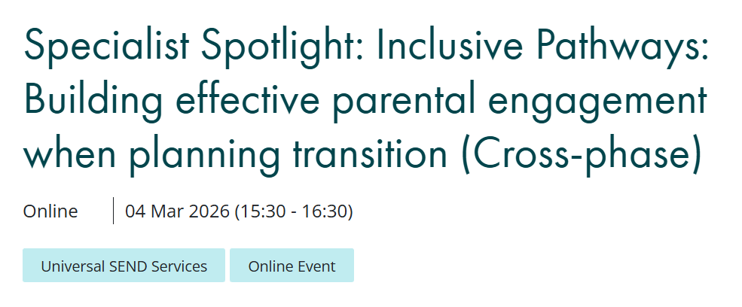
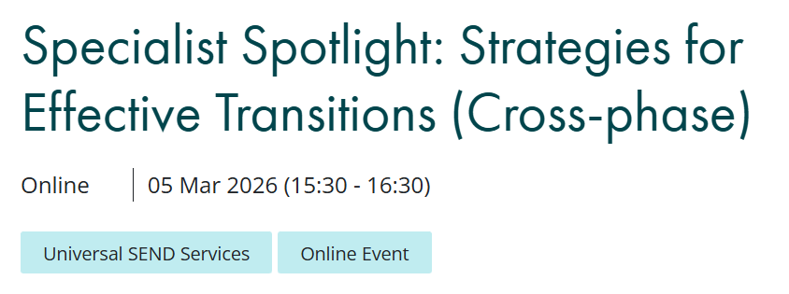
Webinars
Book here - link
Book here - link

