Slide 1
The Role of the SENCo
THE CHILDREN & FAMILIES ACT 2014 Part 3: SEND
Session 2

Slide 2
Feedback from last session
Referrals for an ADHD or Autism Spectrum condition:
Easiest to do via the Thriving Kirklees Website:
www.thrivingkirklees.org.uk
If you are not sure there is a 24 hour phone service that can help
For other mental health advice you can also ring ASK CAMHS on
01924 492183 (or speak to your EWB lead in school)
Parents and young people can also ring ASK CAMHS themselves
Notes:
Also mention PCAN slides

Slide 3
Activity 1
People Bingo [Prize]
Feedback on The Golden Thread
Notes:
Sarah to open
Stan to do golden thread and SEN Register

Slide 4
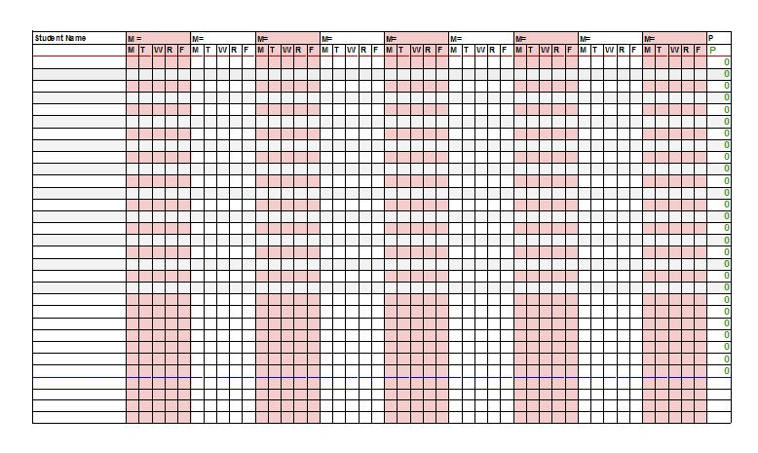
The School’s Special Needs Register
Notes:
Stan

Slide 5
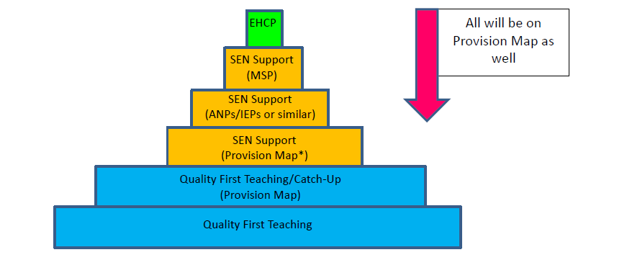
Quality First Teaching
Notes:
Stan

Slide 6
Kirklees Graduated Approach Guidance
Notes:
Christine: allow a bit of time for participants to have a quick look at all the documents

Slide 7
What the Code says about schools : Quality First Teaching
Teachers are responsible and accountable for the progress and development of pupils in their class. High quality, personalised differentiated teaching is the first step in responding to pupils who may have SEND. The majority of pupils can make progress through such teaching
Notes:
Christine:emphasise that teachers are responsible

Slide 8
What the Code says about schools : Quality First Teaching
Class and subject teachers supported by the senior leadership team, should make regular assessments of progress for all pupils. Where pupils are falling behind or making inadequate progress given their age and starting point they should be give additional support
Where pupils continue to make inadequate progress, despite high-quality teaching targeted at their areas of weakness, the class teacher, working with the SENCO should assess whether the child has a significant level of need
For higher levels of need, schools can make referrals to draw upon more specialised support from external agencies and professionals e.g. speech and language therapy or visual impairment (VI) outreach.
Notes:
Christine

Slide 9
Activity 2
Case Studies
What should the class teacher do?
What should the SENCo do?
Where would they sit in the Pyramid?
Notes:
Christine: needs Graduated Approaches docs and guidance

Slide 10
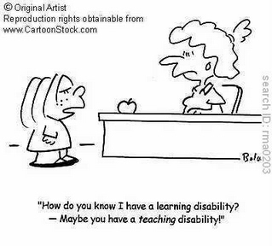
Provision Mapping
Who should be on the Provision Maps?
- Catch-Up Children
- SEN Support
What documents should you have?
- It doesn’t matter as long as they
are (or it is) SMART, evidence
progress and are termly reviewed
Accounting/budget implications
- £6,000 already in your budget
Notes:
Stan

Slide 11
Examples of Provision Maps
Look at different examples of provision maps: comments/questions welcomed.
Provision Maps do not have to be the same, but they must show which children are doing which intervention and indicate how each intervention is tracked/measured and time spent/cost.
Notes:
Stan. SENDACT are due at 2pm – we’ll have to be flexible around them!

Slide 12
IEPs/ANPs etc…
Some children at SEN Support benefit from having a Profile or an Individual Education Plan (IEP) or an Additional Needs Plan (ANP).
Examples of Profiles/PLPs/IEPs/ANPs
Notes:
Stan

Slide 13
SENDACT

Slide 14

Time for a break!

Slide 15
ETHOS Multi-Academy Trust
Marcus Farrington - ETHOS
Helen Plaskitt – Reach Academy
Phil Ringsell – Engage Academy
(Formerly PRS)
Notes:
Due at 3:15

Slide 16
My Support Plan (MSP)
Where SEN has been identified and a child or young person and their family are supported by other professionals too (e.g. SALT/EP/OT) the Kirklees ‘My Support Plan’ provides a more coordinated and personalised planning approach
My Support Plan should be seen as an ongoing working document or tool that uses a person-centred approach to co-ordinate , plan and meet the needs of the child or young person
Notes:
Lottie

Slide 17
The key underpinning principles of the SEN Code of Practice are central to My Support Plan (“The Golden Thread”)
captures views, wishes and feelings of child and their family, promoting high aspirations
details the support and provision necessary to achieve best possible outcomes for the child
active participation at every stage by child and their family.
preparation for key transitions and adulthood at every stage
Kirklees template for My Support Plan, produced in liaison with parent/carers, education, health and social care professionals and practitioners, is available on the Intranet
Notes:
Lottie

Slide 18
My support plan
7 sections
1. About me ( including goals and aspirations for the future)
2,3 & 4. My needs ( education , health , social care)
5. My outcomes and the provision needed to help me achieve them
6. Reviewing My Support Plan
7. Appendices
Notes:
Lottie: remember the person-centred planning tools

Slide 19
Aspirations
Need not be realistic
Can be whatever the child or young person wants
Helps everyone to have a better understanding of what is motivating the child/young person
My Support Plan takes into account short term aspirations (6 – 12 months) and long term aspirations (when I am an adult)
Local authority are not accountable for their fulfilment
Notes:
Lottie. Examples: B would like to put her school uniform on without any help; B would like to climb up a slide all by herself; B would like to sing and dance on a stage; B would like to own her own pet dog

Slide 20
Aspirations: Examples
Craig would like to have friends
Bruno would like to go to a party
Fatima would like to ride a bike
William would like to sing and dance on a stage
Ed would like to have his own pet
Mohammed would like to be a vet
Rihanna would like to be a racing driver
Sansa would like to be a nurse
Notes:
Lottie

Slide 21
Needs
Explains what the child’s strengths are, what the child has difficulties with and what impact their needs have on their ability to learn.
4 sections of need:
Special Educational Needs: linked to the 4 broad areas of need as outlined in the code:
- Cognition and learning
- Communication and interaction
- Social and emotional
- Sensory and or physical.
Health / medical needs that relate to child’s SEN
Social care needs that relate to child’s SEN
Preparing for key transitions/Preparing for Adulthood
Notes:
Christine. Example: C has difficulty understanding spoken language and needs visual support structures to allow him to make sense of the world around him. He is starting to use some very simple visual supports to help him communicate his needs to others.
E has limited attention and listening skills for his age and struggles to show any sustained focus beyond a few seconds. He is beginning to show some increased curiosity with sensory based activities such as sand and water play but this is still limited.
F finds regulating her emotional responses very challenging and can become agitated and stressed very quickly when she is in a situation that needs her to share or take account of other children’s needs. She will often lash out and snatch things and has on occasions bitten children.
G has cerebral palsy and struggles with balance, posture and independent movement. He can move around the unit with a frame and is starting to show some increased independence transfering from a chair to his frame.

Slide 22
http://intranet.kirklees.gov.uk/Policies-and-procedures/Service/Schools/Special-educational-needs/Guidance-notes,-documents-and-forms/SEN-Support.aspx
(also see pg.25 & 26 of Graduated Approach Guidance for direct links to the MSP documents)
Notes:
Christine

Slide 23
Outcomes
The benefit or difference made to the child as a result of an intervention
Outcomes will set out what needs to be achieved by the end of a phase or stage of education
Important to consider both what is important to the child (what the child wants to achieve themselves) and what is important for them (as judged by others with the child’s best interests at heart)
Outcomes are holistic (shared between education, health and care where appropriate) and person centred
DON’T FORGET, THEY NEED TO BE SMART!
(specific, measurable, achievable, realistic, time specific)
Notes:
Stan. Example phrases :
1) By the end of Reception D will be able to understand and respond to simple 2 part instructions
2) By the end of foundations stage D will be take part in a familiar turn taking game with another child
3) By the end of Foundation stage D will be able to recognise numerals to 5 and match them to an appropriate amount of objects.

Slide 24
Outcomes Video:- http://intranet.kirklees.gov.uk/Policies-and-procedures/Service/Schools/Special-educational-needs/Guidance-notes,-documents-and-forms/Training-resources/Person-Centred-Approach
Alasdaire Duerden DfE Training: SEND Support and Aspiration – Person Centred Planning and Writing SMART Outcomes:
http://intranet.kirklees.gov.uk/getattachment/ceff674b-1bd3-48c1-b01d-96140b94184f/9.%20Training%20-%20Person%20Centred%20Planning%20and%20Writing%20SMART%20Outcomes%20-%20Alasdaire%20Duerden,%20DfE.aspx
Notes:
Stan

Slide 25
Examples: Outcomes
By the end of Reception, Elijah will be able to focus on a given task for up to 5 minutes. He will follow a visual timetable to guide him in his activities and will understand and use the sign for finished.
By the end of Key Stage 1, Hafsa will be able to blend and segment CVC words.
By the end of Key Stage 2, Yusuf will be able to take turns in a playground game with 3 friends independently.
Notes:
Stan

Slide 26
Remember……….
Aspiration – “with high aspirations and the right support, the vast majority of children and young people can go on to achieve successful long–term outcomes in adult life” (code of practice 1.39)
Aspirations must be challenging
Outcomes – “ An outcome can be defined as the benefit or difference made to an individual as a result of an intervention” (code of practice 9.66)
An outcome is something that happens or changes in the child / persons life. What we might call a ‘result’
Notes:
Stan - Focus on the strengths that can be built on, not on the barriers.

Slide 27

Making it real
Aspiration: I would like to be a Florist and own my own shop (from end of Section A)
Outcome:By the end of 2017 I will have attended a local night class on Floristry and will be confidently making bouquets.
Notes:
Stan

Slide 28
Activity 3
Using the previous aspiration, think of an outcome that would be achievable at the end of each key stage (KS4, KS3, KS2, KS1 and EYFS)
Bear in mind what is important to the child/young adult and what is important for you as their educator
Keep it SMART
Notes:
Stan: ask for feedback on outcomes created

Slide 29
Provision
The intervention / resource that is to be provided in order to work towards attaining the outcome.
SEN provision is provision that is additional to or different from that made generally for other children of the same age.
Notes:
Christine

Slide 30
Provision (cont.)
Provision is broken down into 6 aspects:
steps I will make towards achieving an outcome (relevant for at least a year potentially)
short term targets (6 – 8 weeks possibly but can be reviewed / amended regularly according to impact and progress observed)
approaches / programmes / resources needed
who will deliver it
frequency of offer
costings
Notes:
Christine - Emphasise short term targets are realistic – need to demonstrate progress even if only small steps.

Slide 31
No. of outcome | Steps I will make towards achieving this outcome (each outcome may need more than one step) | Short term targets (each step may need more than one target) | What needs to happen to help me achieve this outcome? | Who will do it? | How often? (frequency and duration) | Resources required (including weekly costs)
1
2
3
4
5
6
7
Notes:
Christine

Slide 32
My Support Plan - reviewing
Each template is prepared to accommodate up to three review cycles.
Reviews need to be at least termly however provision including short term targets may be reviewed and amended more regularly than this.
Progress should always be monitored in the light of the longer term outcomes and aspirations that the child or young person wants to achieve.
At the 3rd review ensure all sections of the My Support Plan are fully reviewed and updated with a new plan produced. Amendments do not need to be included in the new plan as the previous one has them recorded.
The front cover has a place to record which number My Support Plan you are producing e.g. MSP 1 MSP 2 etc..
Notes:
Lottie: benefits of completing electronically

Slide 33
Section 6: Reviewing My Support Plan Date of review: 1st review (R1)
No. of outcome | Progress towards outcomes in My Support Plan (to include whether the steps I will make towards achieving this outcome have been met, partly met, not met or need to be changed)
1
2
3
4
5
6
7
What is working well with provision and support and needs to continue?
What isn’t working well with provision and support and needs to finish or change?
Should anything new be introduced to match the parent/child’s goals and aspirations?
At this review, update My Support Plan to set new targets, make adjustments to provision etc. Please reference these updates with an R1 and the date of the review in Section 5. If any provision is not continuing then strikethrough in Section 5. If no strikethrough then this will indicate that provision is continuing and if it is being added to following this review please reference these additions with an R1 and the date of the review.
Notes:
Lottie – Include any tips on how can the targets be practically delivered in the classroom on a termly basis

Slide 34
Remember……..
My Support Plan will only be produced for a minority of children with special educational needs
A My Support Plan replaces the need for an IEP/ANP/BSP
The SEN graduated response is still key to our practice with quality teaching and practice being the foundation of our work
When a child is at ‘SEN Support’ this does not automatically mean that a My Support Plan should be produced
The production of a My Support Plan does not automatically mean that a request for an Education Health and Care needs assessment will be taking place
Some SEN Support Services that offer very specific and specialist support may ask to see the ‘My Support Plan’ as part of their referral information. This will help them to see what has already been put in place to meet the child or young person’s SEN and to help them to determine what further support they can provide.
Notes:
Lottie

Slide 35
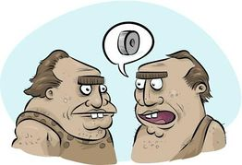
Activity 4 - My Support Plan (MSP)
My Support Plan example of good practice
Discussion on tables
Feedback as a group
Any questions?
Notes:
Lottie to ask for feedback. Everyone to be involved with any questions that arise

Slide 36
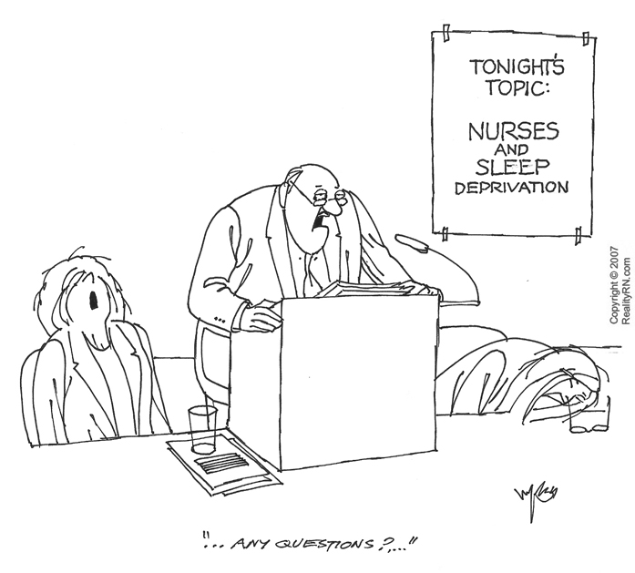
Any other questions?
SENCos
Notes:
All

Slide 37
Social, Emotional and Mental Health
(Behaviour – but you can’t call it that any more!) COP 6.82
Graduated Approach for SEMH for advice on:-
What constitutes Quality First Teaching in terms of SEMH
http://intranet.kirklees.gov.uk/getattachment/2622728c-5768-4013-b89d-5c8ea88c054e/3.%20Guidance%20for%20Schools%20-%20Graduated%20Approach%20-%20SEMH.aspx
Not all SENCos are the Emotional Well-being Leads for their school: it is important to know who your EWL is, as the have access to a range of resources and training. If your school doesn’t have an EWL, it’s worth contacting Josie Williams at Northorpe Hall to discuss the advantages of having one
Notes:
Stan- COP states that persistent disruptive or withdrawn behaviours do not necessarily mean that a child or young person has SEN. It is the social and emotional needs or other needs that might cause such behaviour that need addressing in any plan. All schools need to show clear strategies for assessing and addressing the needs.

Slide 38
Social Care
The social care section does NOT mean SEMH need
Contact Designated Safeguarding Lead (DSL) in school to see if there is any social care involvement
If no social care involvement, leave social care outcomes blank
If yes, external social care professionals need to be involved to develop shared social care section outcomes e.g. lead professional, lead social worker, school nurse, health visitor, family support worker
If in doubt if there is anything in place ring [“Duty and Advice Team”] 01484 456840 who can tell you who the lead professional is
Notes:
Stan

Slide 39

Social Care
My support plan should reflect shared outcomes/targets in the Single Assessment (old EHA, CAF) /Child in Need/Child Protection/Looked After Child that relate to that child
Useful checklist at the beginning of the MSP template
Consider aligning Social Care and SEN review meetings
Or using Social Care reviews to review progress of Social Care outcomes on my support plan
Examples of Social Care meetings, reviews are [Team Around the Family, E-Personal Education Plan, Virtual School]
Notes:
Stan

Slide 40

Health
The health section is only used where there is external health involvement which influences/impacts upon education
Useful checklist at the beginning of the MSP template
Contact designated person in school for health care plans
If no involvement, leave health outcomes blank
If yes, external health professionals needs to be involved to develop shared health section outcomes e.g. physio, school/community nurse
Consider using healthcare plan reviews to review progress of Health outcomes on my support plan
Notes:
Christine

Slide 41

When to review?
Please don’t panic when we tell you this, but…
EVERYTHING at least TERMLY:
Provision Maps
ANPs/IEPs or similar
My Support Plans (see Guidance)
EHCP (comprising 1 full annual and 2 ’light-touch’ reviews – see Guidance) UNLESS there are significant changes when the full review may be brought forward.
Notes:
Christine

Slide 42

That’s all for this week – see you on February 12th

