Slide 1

SEND: Support and Aspiration
Person Centred Planning and Writing SMART Outcomes
Alasdaire Duerden

Slide 2
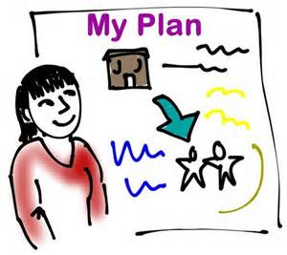
Session 1: Person-Centred Planning

Slide 3

The Vision – a new 0-25 SEND system
Early identification & support
Transparent information
Increased focus on life outcomes
Person-centred – greater choice & control
Joined up services – better customer experience

Slide 4
Children & Families Act 2014
(Code of Practice Chapter 1: 1.3-1.12)
S19 – Local authorities must have regard to:
Views, wishes and feelings of C/YP & parents
Importance of participating in decision making
Assisting C/YP & parents to participate
Achieving best possible outcomes for C/YP

Slide 5
Person-Centred Planning
(Code of Practice Chapter 9: 9.20-9.26)
Personalises
Includes
Empowers
Achieves
Learns

Slide 6
Questions

Slide 7

Session 2: Why Outcomes are important

Slide 8



Outcomes
(Code of Practice Chapter 8: 8.7-8.40)
Outcomes
Independent
Living
Community
Participation
Better
Health
Work

Slide 9
Outcomes: SEN Support
(Code of Practice Chapter 6: 6.1-6.7 & 6.36-6.56)
Assess
Review
Plan
Do

Slide 10
Outcomes: Statutory Requirements
(Code of Practice Chapter 9: 9.150-9.156 & 9.199-9.210)
S39 (10) New EHC plans for 19-25 year olds
LAs must consider whether young person requires additional time to complete education/training
S44 (5) Reviewing EHC plans for 19-25 year olds
LAs must have regard to whether educational or training outcomes in the Plan have been achieved
S45 (3) Ceasing EHC plans
LAs must have regard to whether educational or training outcomes in the Plan have been achieved

Slide 11
Policy: 19-25 year olds
(Code of Practice Chapter 9: 9.150-9.156)
Effective preparation for adulthood
No automatic, statutory entitlement
Outcomes and/or additional time
Annual reviews and effective exit planning
Tribunal – not suitable/not efficient

Slide 12

Exercise 1: Writing an Outcome
Think of a young person with SEN that you know. Write at least one outcome that will help progress them (or someone like them) towards the following aspiration:
To be able to live in my own house near my Mum and Dad

Slide 13
Questions

Slide 14
Session 3: Writing SMART Outcomes
S
pecific
M
easurable
A
chievable
R
ealistic
T
imebound

Slide 15

Writing SMART Outcomes
(Code of Practice Chapter 9: 9.64-9.69)
Focus on progression towards aspirations
Benefit/difference made by an intervention
What is important to/for child or young person
Personalised, not a service description/process
SMART – specifies what achieved by when
Completion: phase/stage of education

Slide 16

Outcomes: Top Tips
Write outcomes as though already achieved – it makes them more compelling:
“By [insert date/key stage etc] child A will be able to [insert what they will be able to do]
Write outcomes as moving towards something positive, not away from something negative
Don’t embed the solution in the outcome

Slide 17
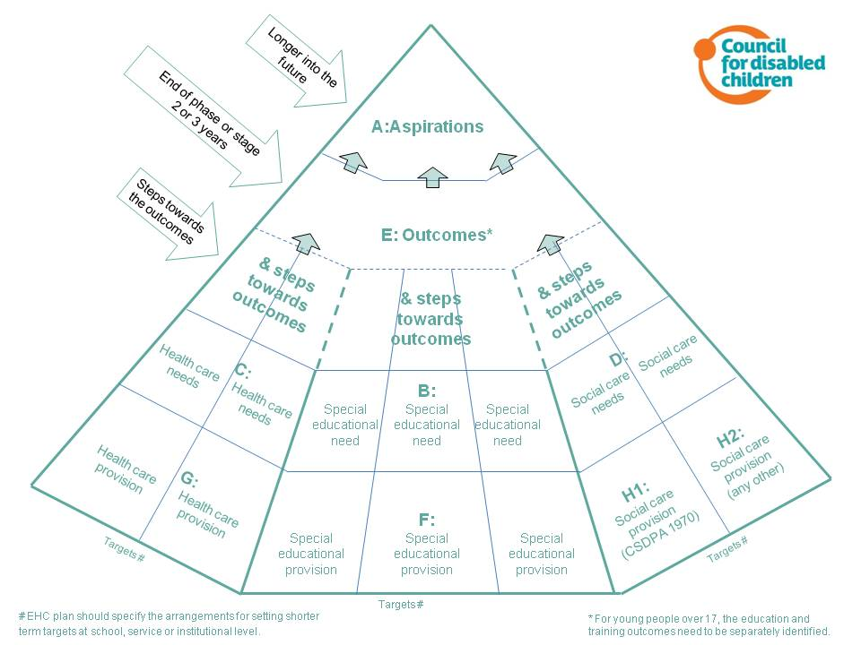
Outcomes Pyramid
Start Here

Slide 18

Reverse Engineering Provision!
What would 1 hour of Speech and Language Therapy:
Give you?
Individual time with a S&L Therapist
Do for you?
Help me be more easily understood
by my friends, reduce frustration
Make Possible for you?
Friendships, social activities,
confidence with other people etc.

Slide 19

Reverse Engineering Provision!
What outcome are we trying to achieve?
By the end of reception, I will be understood by my friends and can play with them at playtime [important to] and in the after school club on Wednesdays without anyone getting frustrated [important for].

Slide 20

Reverse Engineering Provision!
If this is the outcome, how might we achieve it?
SLT Programme delivered in a classroom by a TA
Social activities outside of school
Help from parents, wider family to use signs at home
Encouraging friends to learn signs
Simplified language and instructions in class
Giving time to think and respond
For any single outcome there will be a range of ways to achieve it – don’t get stuck with considering just one solution!

Slide 21
Outcomes: Good Examples
By the end of this school year, I will be able to communicate in sentences so that I can be understood by my friends and I can play happily with them at break time every day without getting frustrated at not being understood.
By the end of key stage 4, I will be able to use the bus to get to school every day by myself and to go shopping on my own once a month on Saturdays.
By the end of Year 1, I will be able to go to the toilet by myself so that I have no more accidents and I am able to clean and dress myself afterwards.
By the end of this year, I will be able to dress for and travel to work, turn up for my shifts on time, talk to customers and colleagues appropriately and do a good job.
When I am well enough, to be able to go out and spend time with my friends twice a week and maintain my oxygen saturation at above 96% when I am out. Achieved by September 2015.

Slide 22
Exercise 2: Writing a SMART Outcome
Think of a young person with SEN that you know. Write at least one SMART outcome that will help progress them (or someone like them) towards one of the following aspirations:
To have a paid job in the Fire Service
To be in a relationship and have sex
To be able to drive my own car
To be able to live in my own house near my Mum and Dad
To learn more about History at University
To compete as part of a local sports team
To run my own business or social enterprise selling jewellery

Slide 23

Contact Details
Alasdaire Duerden
SEND Reforms: Programme Lead
0114 2037787 / 07785 362170
alasdaire.duerden@sheffield.gov.uk

