Slide 1


Welcome to I-APDR ‘How to..’ guide
Education Safeguarding and Inclusion
This guide will talk you through how to use the I-APDR

Slide 2



Best practice
Information is gathered from a combination of the CYP, family and professionals
Should be in the CYPs words as far as possible. You can use images.
Should be informed by assessment
Should be strengths focused
Should be reviewed at least termly
Reviews can be recorded on the document as ‘track review’ using a different colour each time or you can use a fresh document each time
Should be clear about the provision in place, the time allocated, the level of support and expertise required
Should clearly track impact and progress made against outcomes

Slide 3
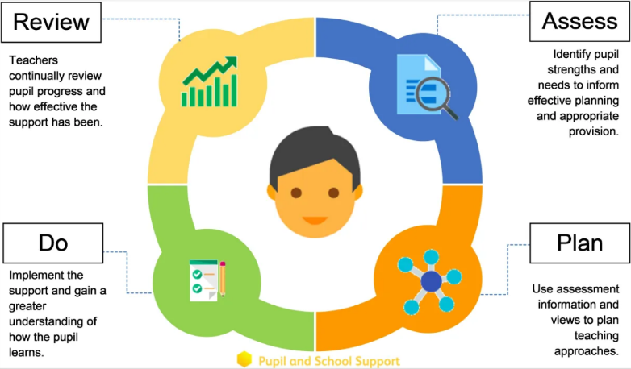
SEND underpinned by

Slide 4
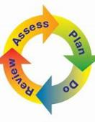
What it is?
A simpler way to record provision and impact as well as submit evidence for the EHCNA
A way to support you in embedding an Assess, Plan, Do and Review process with staff and an embedded aspect of your inclusion cycle. Supports a graduated approach
Can be used within school to inform teaching practice and QFT, to support EHCNA, to support EHCP review
Is non-statutory
You can still use the MSP if that is your preference
I-APDR
Individual
Assess
Plan
Do
Review

Slide 5
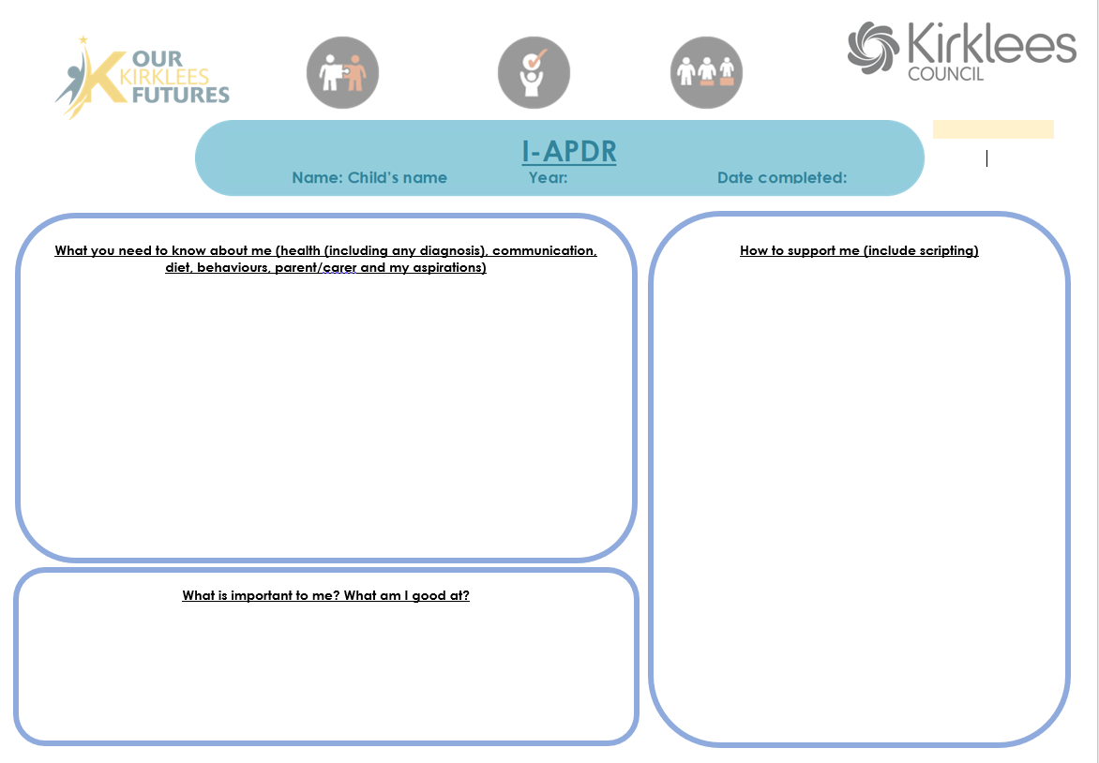

Slide 6
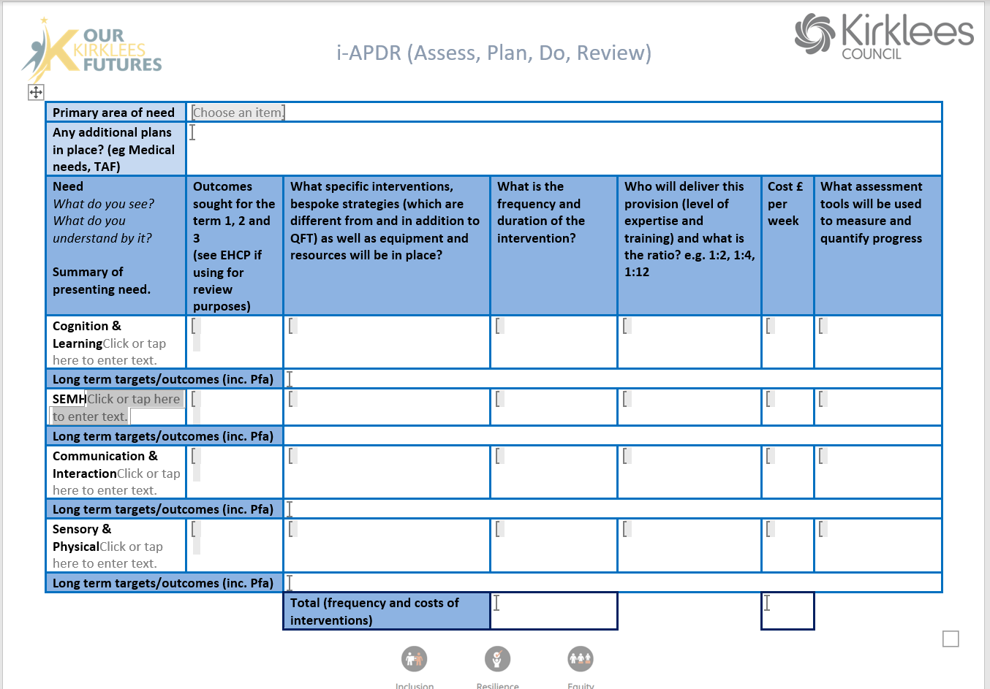

Slide 7
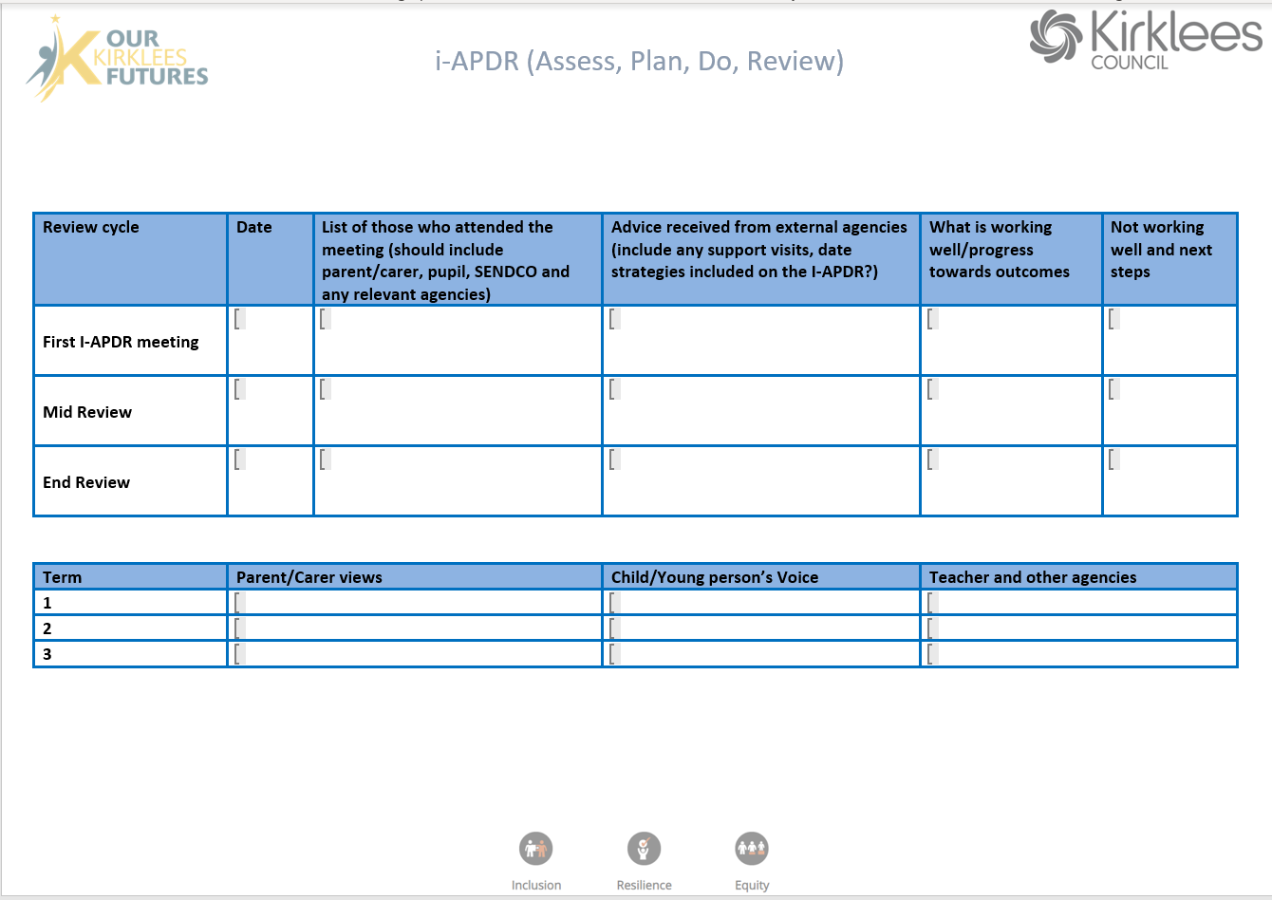

Slide 8
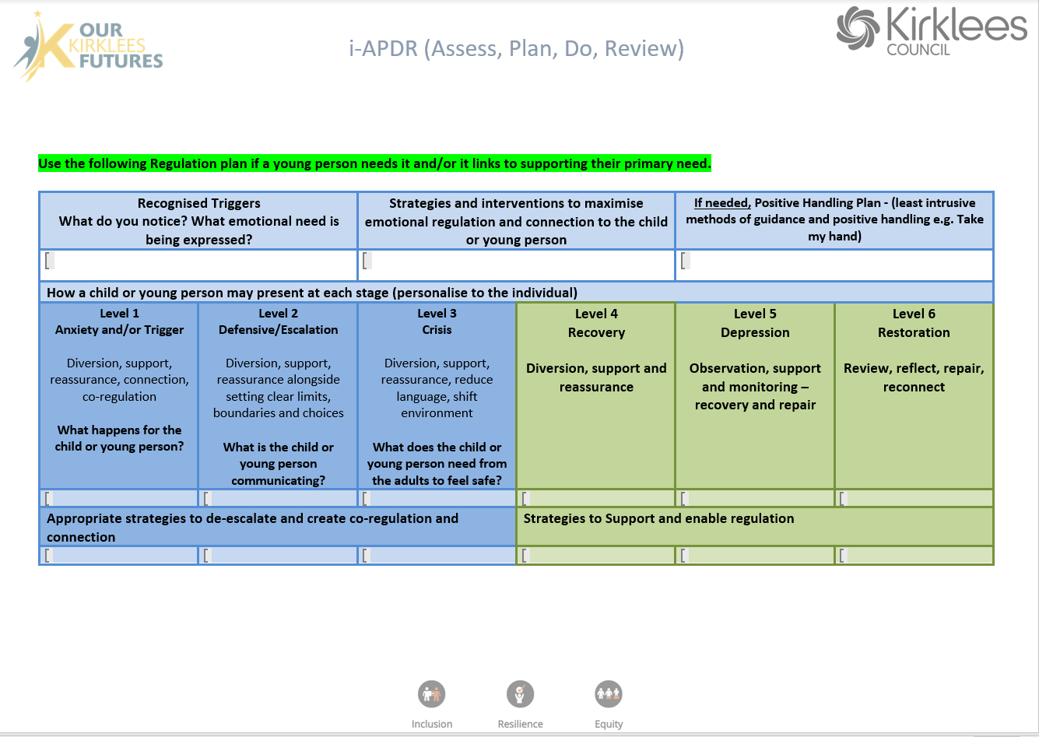

Slide 9
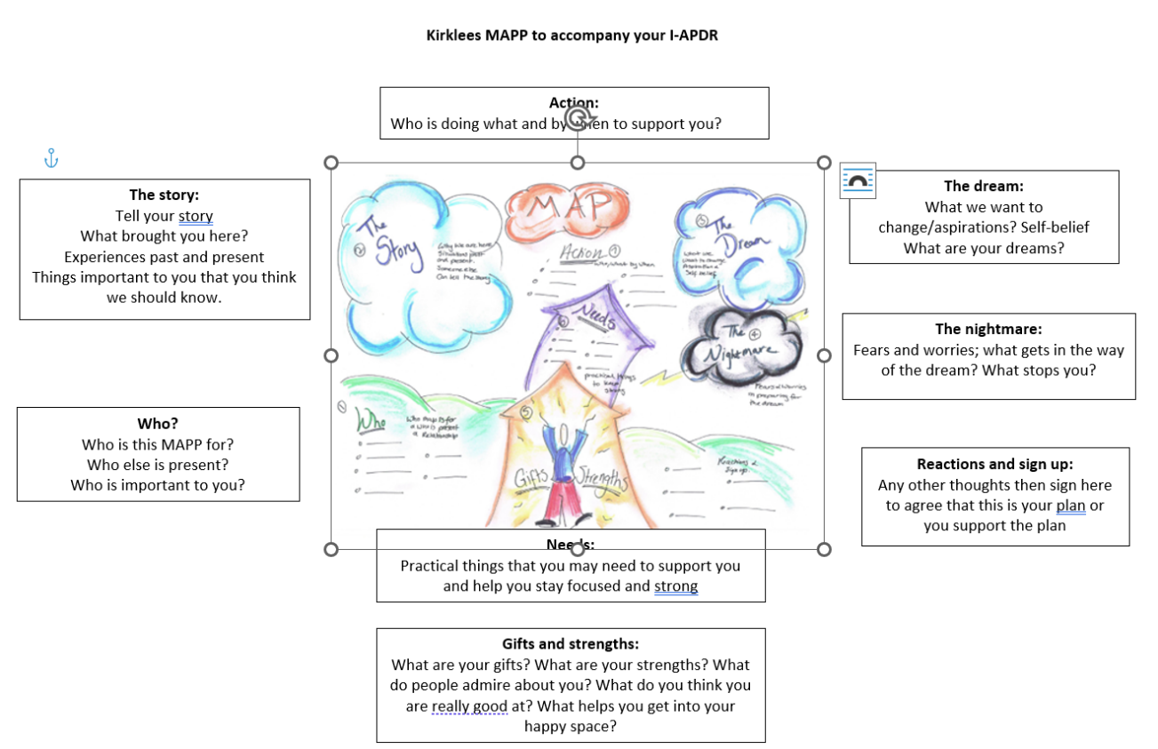

Slide 10

Assess
Teacher assessment
Specific need assessment
Observation
Parent/carer assessment
Profile checklists (baseline assessments)
Strengths and needs: move away from deficit

Slide 11
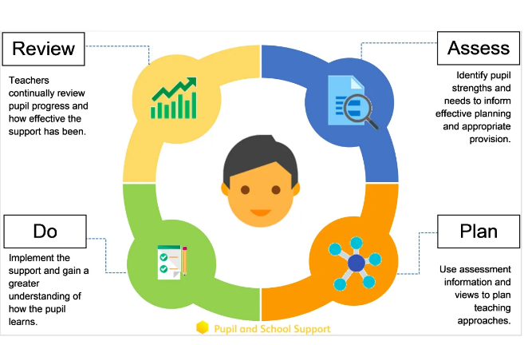

Plan and Do
Set targets informed from assessment
Identify provision (whole class and bespoke)
Use the Inclusive High Quality audit toolkit
Implement and be prepared to review and refine

Slide 12
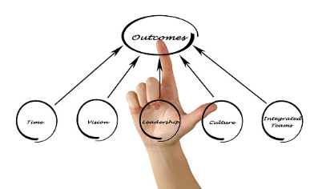
Outcomes
What does each individual want/need?
What is the overall picture?
360 the view: school, home, individuals
Do they align? What needs to more holistic?
What can be done differently?

Slide 13

Gathering the child/young person’s views

Slide 14

What CYP would like…
Ask me what my access needs are, before you do anything else
Tell me a bit about yourself before I meet you ( a photo profile or similar) Are you the right person for me?
Ask me how best to communicate with me
Adjust your communication to ‘meet me halfway’.
Offer me choices of ways to communicate e.g. email, text , face to face, images, drawing, letters, through an advocate
Think universal design and accessibility; things like captions on video calls should be business as usual
If you can’t answer my question straight away, let me know you’re working on it and will get back to me
Communicate directly with me, not just through my parents/carers
Support me to advocate for myself and help me to develop the skills to do this effectively ( ‘let me have a say and give me some help to have a say’)
Be prepared to develop your own skills in listening and communicating with me
Make an effort to understand, and don’t judge
Respect me, my experiences, and my perspective
‘How people talk to you and how they explain things is important; explain things clearly’

Slide 15

What this may look like…

Slide 16
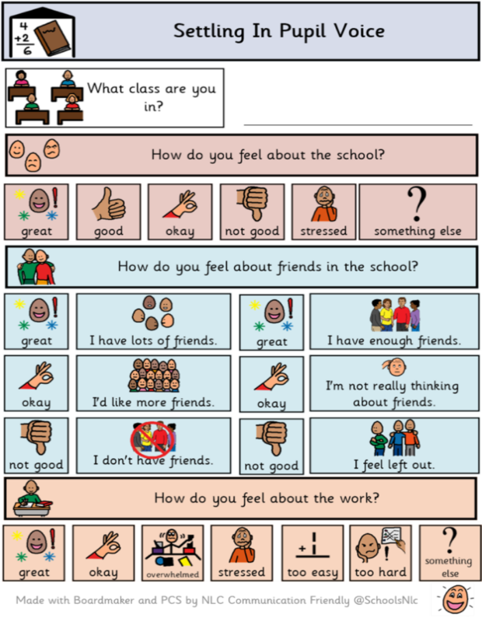
· Always offering a variety of ways for young people to express their views
· Not assuming that speaking is always the ‘best’ way to communicate
· Drawing stick men on a note pad to illustrate a conversation, or using natural gestures; it doesn’t have to be hi-tech or look fancy. A helpful list of low-tech communication supports is available here https://www.rhn.org.uk/content/uploads/2020/08/Low-tech-AAC.pdf
· Recognising that speaking children and young people may benefit from using non-speaking ways to communicate at times. https://www.assistiveware.com/learn-aac/support-communication-for-part-time-aac-users
· Doing an activity together such as sensory play or making a model .
· Using texting or messaging apps. Mind of My own is a good alternative to this to address any safe-guarding concerns https://mindofmyown.org.uk

Slide 17
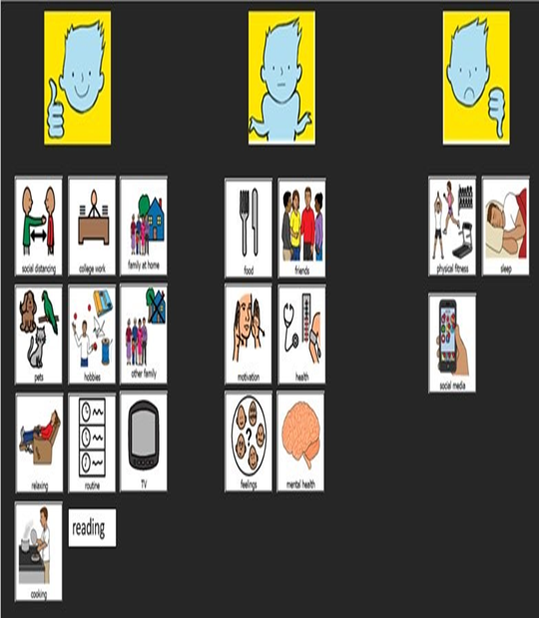
Talking mats

Slide 18
Activities to support pupil voice could include
· Creating a Lego model of your ideal school to enable a child to show what they like and don’t like at school
· Drawing or sculpting from playdough someone who is important them such as a teacher , family member or pet. This enables them to start thinking about the qualities they like about that person, and any they would change. This can be done in the abstract to prevent it getting too personal, for example ‘what would the best teacher in the world be like?’
· Creating a ‘worry monster’ from art materials that represents their worries about transition, for older children this could be made more age appropriate by focussing on creating an anime character or super-villain
· Using a tablet to create an online book about themselves . One free and accessible platform for this is https://bookcreator.com. There is an ‘All about me’ journal
Some alternative and augmented communication (AAC) ideas that are free and easy to access
· Free phone apps available from app stores such as C board ( picture based) and Speech Assistant ( text and emoji based)
· Drawing ( you don’t have to be an artist!)
· Note pad and pen ( sometimes it is easier to write down difficult things than find the words verbally) · Talking mats – https://www.communicationmatters.org.uk/what-is-aac/types-of-aac/talking-mats/
If you are interested in finding out more about AAC here are a couple of useful links http://complexneeds.org.uk/modules/Module-3.1-Communication---augmentative-and-assistive-strategies/All/m09p010a.html http://www.autismtoolbox.co.uk/communication-supports-aac

Slide 19
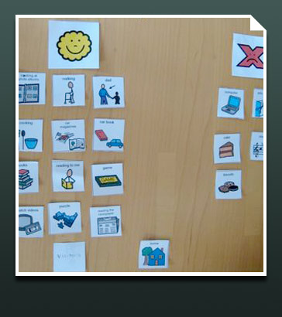
Use this link for further information
https://schools.local-offer.org/childs-journey/voice-of-the-child/how-to-gain-pupil-voice/
Visual observations and written notes
Use of video recording – share in discussions
Books and photographs to prompt discussions
Puppets/dolls/small world play/avatars
Questioning and alternative frameworks such as letter writing
Music/artwork/comic strips/story boards
Providing choices including using Talk Mats and visuals
Drawings
Story writing – can provide a ‘space’ between the child or young person’s internal world and external reality and help them make sense of emotions and deal with issues which may otherwise be overwhelming.
Sand tray and other play-based strategies

Slide 20

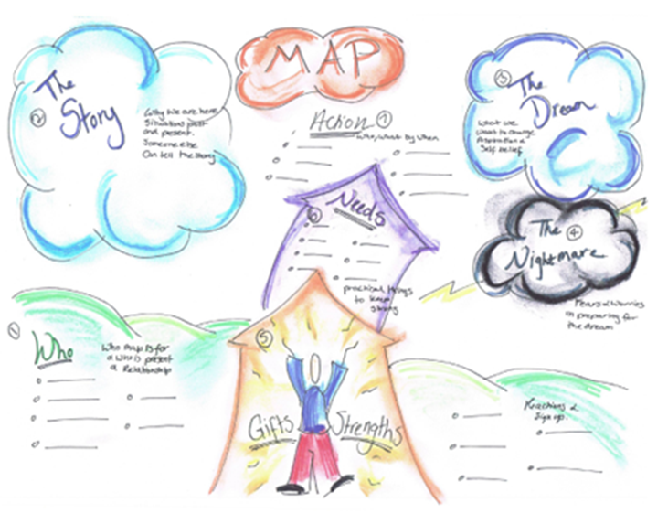

Completing the M.A.P
(Making an Action Plan)
The M.A.P is a person centred tool that is about making a difference
It should be completed over a number of sessions
Should be facilitated by an adult the CYP knows and likes
Can be completed in a variety of ways: this is just one idea!
Is about the CYP, done by the CYP and highlights what is important to the CYP
Link to MAP

Slide 21

Step-by-step guide to the MAPp
(Making Action Plans personal)
Allocate to a keyworker who knows the CYP well and has an established, trusting relationship with the CYP
Ensure you model how to complete the MAPP
It can be completed in several sittings
It needs to be a meaningful process and completed ‘with’
Use visual prompts, open frame questioning, games etc. Be reflective and think out aloud. Direct questioning can shut a CYP down. They may not know what their strengths are etc and may say what they think you want them to say
Model up and complete one alongside the cyp so they can get ideas from you
Bring in relevant parties that the cyp wants to be a part of the process
Draw, have fun! Doodle and let the cyp own the document
Draw out any links to the EHCP if they are relevant and/or discussed

Slide 22


Steps: it can be completed as a group or on a 1:1
Identify who the MAP is for and invite all in the room to introduce themselves and their relationship with the CYP and to each other.
This is where the CYP tells their story and why they are here. The person can describe in detail situations past and present. If this is difficult the person can nominate someone to tell their story. The story should be recorded and then agreed by the person. This will allow the person to tell the story once.
The dream is an opportunity for the person to say what they want to change about their life and express what their aspirations, hopes and dreams are.
The person is then asked to talk through their fears and worries in preparing for the dream. This is referred to as the nightmare. This wording may need changing according to the CYPs needs and perceptions.
The group then support the person by identifying and listing their gifts, strengths and talents.
The group then thinks about the best way to move forward towards the dream and away from the nightmare for the person.
The next stage of the process is to develop the action plan, listing who will do what, where and when

