Slide 1
The Role of the SENCo
THE CHILDREN & FAMILIES ACT 2014 Part 3: SEND
Session 1

Slide 2
Aims of the Course
To help you develop a clearer understanding of the SENCo’s role and responsibilities
To give you the opportunity to identify and work on some of your immediate priorities

Slide 3


www.sendgateway.org.uk
Or just search SENCo induction

Slide 4
Activity 1
Introduce yourself to the people on your table and find out:
Their name and school;
How long they have been a SENCo;
How they got to be a SENCo;
Their favourite ‘get-me-through-the-paperwork’ reward
Be prepared to feedback!

Slide 5
By the end of the course …
I will have a good understanding of the SEN Code of Practice and the Graduated Approach, including Quality First Teaching and the “Golden Thread”
I will have a good idea of what an SEN policy and the SEN Information Report should look like
I will have a secure understanding of the process to request an Education, Health and Care Plan assessment and to review of the EHCP
I will have had the opportunity to familiarise myself with the LA Graduated Approach Guidance and associated documentation including the MSP proforma
I will have considered different examples of Pupil Profiles and IEP/ANP plans

Slide 6
I will understand the elements of funding for SEN (including Pupil Premium) and have knowledge of how to assess different interventions in terms of value for money
I will have considered how to manage and support an ETA team
I will have examined how provision mapping can support a whole school approach to SEN
I will have a good understanding of how to monitor progress and impact, using data effectively to evidence this
I will have an understanding of the likely demands of an Ofsted inspection
I will understand how to liaise with external professionals and Governors.

Slide 7

The Legislation
Show of hands on how many have heard of
The SEN Code of Practice 2014?
Now, how many have actually looked at it?

Slide 8
Links to Useful Documentation
The Code of Practice 2015
www.gov.uk/government/uploads/system/uploads/attachment_data/file/398815/SEND_Code_of_Practice_January_2015.pdf
A Guide for Schools www.gov.uk/government/uploads/system/uploads/attachment_data/file/349053/Schools_Guide_to_the_0_to_25_SEND_Code_of_Practice.pdf
A Guide for Parents and Carers
www.gov.uk/government/uploads/system/uploads/attachment_data/file/417435/Special_educational_needs_and_disabilites_guide_for_parents_and_carers.pdf

Slide 9

Our Vision
Our ambition for children with special educational needs and disabilities (SEND) is the same as for all children and young people – that they achieve well in their early years, at school and in college and lead happy and fulfilled lives.

Slide 10
To achieve our ambition we will create a 0-25 SEND system that:-
Enables children and young people to have the best possible start in life and achieve their potential;
Supports children, young people and their parents to have high aspirations for the future, raising aspirations by not only thinking about what is possible now but thinking creatively about what could be possible in their life;
Ensures that children and young people and their parents are actively involved in planning and decision making, both at an individual and strategic level, and have more choice and control over the support they receive;
Provides joined up education, health and social care services, working together to enable children and young people to achieve the best possible outcomes;
Ensures children and young people are effectively supported to prepare for adulthood, including employment, independent living, good health and participation in community life.

Slide 11

Activity 2
What burning questions do you have about your role?
Please write them on the post-it notes on the table and stick them on the big sheets.
Please put any additional questions on the post-its provided as we go along and, if any remain unanswered by the end of the course, we will try and answer them at the last session.

Slide 12

Activity 3: identifying SEND
Table task:
How do you identify children with SEND?

Slide 13
Identifying SEND
Quality First Teaching (“QFT”) that is differentiated and personalised will meet the needs of the majority of children & young people… special educational provision is underpinned by high quality teaching and is compromised by anything less.
A child or young person has SEN if they have a learning difficulty or disability which calls for special educational provision (“different from or additional to”) to be made for him or her (Code of Practice p.15)
Every school is required to identify and address the SEN of pupils that they support. Schools must use their best endeavours to make sure that a child with SEN gets the support they need – this means doing everything they can to meet children and young people’s SEN.
The level of need for each individual will dictate the level of support and therefore where they will fit within the graduated approach to supporting children with SEN.
Notes:
LOTTIE To leave up during activity 3

Slide 14
Identifying SEND
What does the Code of Practice state?
School leaders and teaching staff, including the SENCO, should identify any patterns in the identification of SEN, both within the school and in comparison with national data, and use these to reflect on and reinforce the quality of teaching.
The identification of SEN should be built into the overall approach to monitoring the progress and development of all pupils.
A mainstream school’s arrangements for assessing and identifying pupils as having SEN should be agreed and set out as part of the Local Offer. A school should publish its arrangements as part of the information it makes available on SEN.
Notes:
Lottie

Slide 15
Whole School Context
Key components of effective early identification:
  teachers having an excellent understanding of every child
  A comprehensive programme of SEN CPD
  The SENCO having a sound understanding of the school; the school’s context, parents, the community and…the children!
  schools having robust systems for progress monitoring
  SLT supporting identification of need and sharing knowledge
The SENCO should have an active part in the whole school progress/attainment monitoring systems and follow up on persistent or unusual patterns of underachievement.
Notes:
Lottie

Slide 16
Identifying SEMH
Challenging behaviour can be regarded as a form of communication and may reflect an unidentified SEN.
Where a child or young person is experiencing regular exclusions, isolations, seclusions etc. this should be picked up by the SENCo

Slide 17
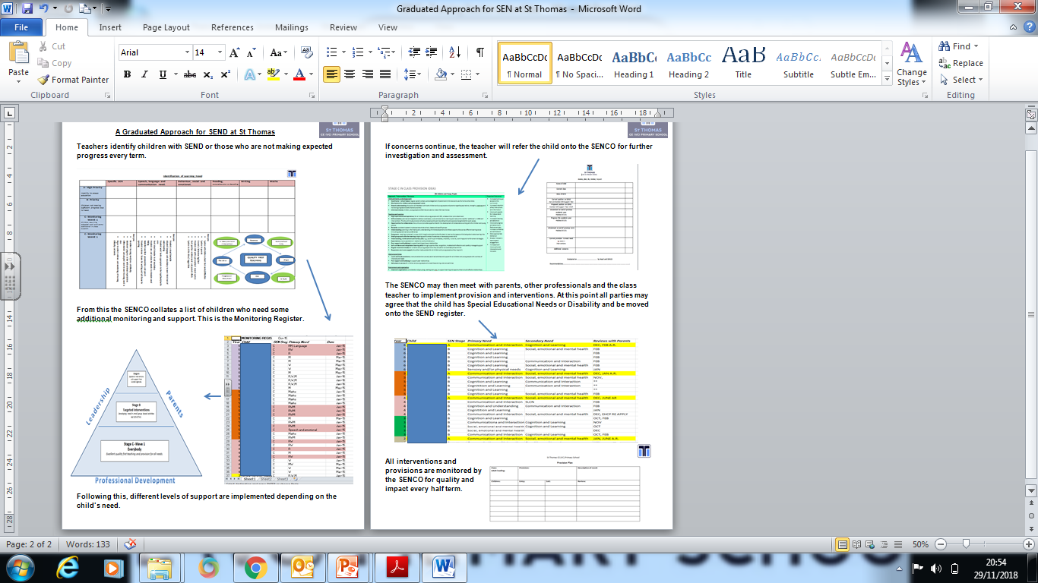
Notes:
Provide individual copies for participants

Slide 18


Slide 19

Time for a break

Slide 20

PCAN
Parents of Children with Additional Needs

Slide 21

The Role of the SENC0
Carol Thomas and Johanna Hull
January 2020

Slide 22
Aims
Our purpose today is:
To give you a brief insight into our complex lives
and
To help you to understand what is important to parent carers and their families

Slide 23
Key Themes
Early Intervention
One size DOESN’T fit all
Outcomes
Scope of caring role
Expectations
Working together
Needs led
Person Centred
Effective reviews
Support
Preparation
Family-Centred
Information
Independence
Empathy
Non-Judgemental
Access
Communication
Prompt Action
Aspirations
Empowerment
Notes:
23

Slide 24
Paediatrics
Genetics
Audiology
Ophthalmology
Nursing Staff
Wheelchair Services
Dietician
Community Nurse
Orthoptics
A & E
Health Visitor
Cochlear Implant Team
Child Development Centre
GP
Orthotist
CAMHS
111
Physiotherapy
Speech and Language Therapy
Sensory Integration Therapy
Occupational Therapy
Continence service
Hospice
Specific Consultants
Clinical Psychology
HEALTH
Educational Psychology
School Transport
Social Worker
Direct Payments
Care Agencies
Peripatetic VI HI MSI teachers
Portage
Nursery
Family Support Services
Adaptations
MAZE OF SERVICES FOR CHILDREN WITH ADDITIONAL NEEDS
SEN Service
Schools
Respite/Residential Services
SOCIAL CARE
EDUCATION
Teaching and support staff
Medical Provision
Equipment Service
Short Breaks
Home Teaching Service
Statement and reviews
Benefits Service
Assessments and reviews
OTHER SERVICES
Out of School Clubs
Transition Teams
Leisure Services
Housing
Benefits Advice
Carer Support Agencies
Children’s Centres
DWP
Charities
Local/National Support Groups
Legal/Advocacy Services
Utilities
Private Therapists

Slide 25
The Parent Carer
Special educational Needs
Researcher
Carer
Administrator
Accountant
Homemaker
Employee
Advocate
Teacher
Parent
Appointments
Negotiator
Employer
Trainer
Co-ordinator
Playmate
Friend
Taxi
Nurse
Social Secretary

Slide 26
Barriers to our journey
Don’t know what we don’t know
Finding relevant information
Not understanding professional roles or processes
Not being listened to (or believed)
Not having a diagnosis (in a culture where diagnosis seems to be a passport to support)
Service/Provision led not needs led approach
Not appearing to meet criteria for support
Late or slow identification of child’s issues
Lack of accountability

Slide 27
What makes our journey easier
Early identification and response to child’s issues
Preparation (with family, child and other professionals)
Helping us to understand why our involvement is important
Having the right information at the right time
People doing what they say they’re going to do
Truly joined up approach (working together)
Commitment from all involved to enabling the child to be the best they can be (aspirations)
Talking and listening
Accountability
Clarity and transparency
Family centred approach
Recognition that “one size doesn’t fit all”
Notes:
Preparation – taking the time up front to make it work: eg. Talking to a parent with a different language, sending a note home in the home school book, making a two-way conversation easier – this is in everyone’s interest.
Understanding the child – if there is a social worker or therapist or someone else involved, this is the opportunity to get everyone’s views in one place – get holistic information about the child can only improve outcomes.

Slide 28
Our hopes for the future
We want to see a collaborative, holistic outcome-focussed approach, all agencies working together putting the child and family at the centre, listening to their views and supporting them in their journey. We all have the child’s best interests at heart.

Slide 29
What can you do ?
???

Slide 30
Thank You

Slide 31




Contact PCAN
07754102336
www.pcankirklees.org
info@pcankirklees.org
Parents of children with additional needs making a difference in Kirklees

Slide 32

Areas of Need
Four areas of SEN need are outlined in the Code:
Cognition and Learning;
Communication and Interaction;
Social, Emotional and Mental Health;
Sensory and/or Physical
Notes:
Sally and Stan

Slide 33
The DfE collects data on 13 areas of need through the school census
Specific Learning Difficulties,
Moderate Learning Difficulties,
Severe Learning Difficulties,
Profound and Multiple Learning Difficulties,
Social, Emotional and Mental Health needs,
Speech, Language and Communication Needs,
Hearing Impairment,
Visual Impairment,
Multisensory Impairment,
Physical Difficulties/Disabilities,
Autism Spectrum Condition,
No Specific Assessment,
Other
Notes:
SENCos need to be aware of what the primary needs of their pupils are according to these categories

Slide 34

The Graduated Response
Once a setting has identified a child as having SEN they must work in partnership with parents and the child
All settings need to adopt the ‘assess, plan, do review’ approach.
All staff have a responsibility in this process. Not just the SENCO.
Notes:
Sally and Stan. Emphasise that this process is one high quality practitioners are familiar with anyway as it is embedded in good practice for all children.

Slide 35
Assess
A child may or may not arrive in a setting with identified needs
If concerns are raised, assessment could include observations, attainment data, use of assessment tools including standardised tests, information from other professionals, and discussions with parents and the child
Such assessments may indicate that the child has a greater difficulty in learning than the majority of others of their age or has a disability which prevents or hinders them from making use of facilities that are generally accessible to others
Assessments should be reviewed regularly and from them a plan of intervention and support identified
Notes:
Sally and Stan

Slide 36
Plan
Once a need has been identified this must be shared with parents if it has not been already
The plan you put together needs to be outcomes led and identify the additional and or different provision you are putting in place at SEN support, to meet the child’s needs (see Guidance p.23)
This may be via provision mapping format or a pupil Profile or IEP/ANP. If the pupil’s needs are particularly significant, you may consider completing a My Support Plan

Slide 37

Person Centred Planning Tools
PATH tool: Planning Alternative Tomorrows with Hope
Notes:
Sally and Stan

Slide 38


Slide 39
http://intranet.kirklees.gov.uk/Policies-and-procedures/Service/Schools/Special-educational-needs/Guidance-notes,-documents-and-forms/Training-resources/PCA-Planning-Tools/PATH.aspx
http://www.sheffkids.co.uk/adultssite/pages/adultshomepage.html
http://helensandersonassociates.co.uk/person-centred-practice/person-centred-thinking-tools/

Slide 40
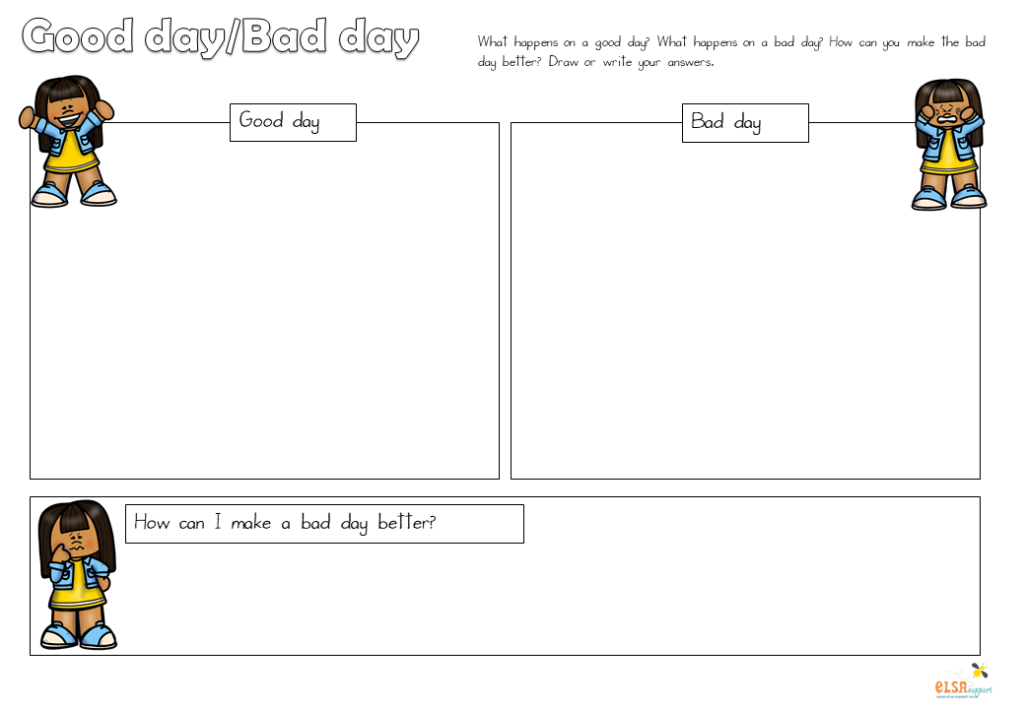
Good Day, Bad Day
Notes:
Sally and Stan

Slide 41
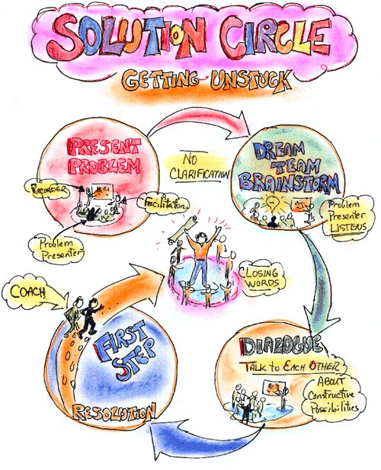
Solution Circle
Notes:
Sally and Stan

Slide 42
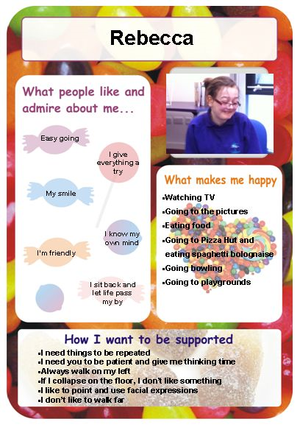
Personal Profile
Notes:
Sally and Stan

Slide 43
Do
Implementation of the plan e.g.
Quality First Teaching (QFT) + Differentiation
Planned group time
1:1 Time
Personalised resources
Targeted 1:1 key worker / adult support
Referrals to external agencies
NB On-going assessment of impact
(see Guidance p.17-20 & 27-29)

Slide 44
Review
Regular review of the plans you have made is an essential part of the cycle. The impact of the quality of support and interventions should be evaluated along with the views of parents and, where possible, the child.
These reviews at least three times a year
Can be formal or informal
Through stand-alone meetings, parents’ evenings or ordinary school reporting systems
Notes:
Minimum 3 x a year

Slide 45
Activity 4: Role of the SENCO
As a table on the post-it notes write down all the aspects of your SENCo role (1 per Post-It)
Then rank them with the one’s that take the MOST time at the top, LEAST at the bottom
Discuss whether the ones at the top are the most important.
Move around and look at other tables’ rankings.

Slide 46
Role of the SENCO
- Code of Practice (Sections 6.84-6.94)
Alongside the Headteacher and Governing Body, to determine the ‘strategic development of SEN policy’
Day-to-day responsibility for co-ordinating provision for SEN pupils
Professional guidance for colleagues
‘Advising on delegation of school’s designated budget for SEN’
A SENCO also has statutory responsibilities for compliance and implementation in relation to SEN
Notes:
Stan

Slide 47
Local Offer
Kirklees Local Offer - What is it and who is it for?
The Children and Families Act 2014 requires Local Authorities to publish a local offer, setting out in one place information about the provision across education, health and social care for children and young people in their area who have SEN or are disabled
It informs parents, carers, children and young people about how they can access accurate on-line information from service providers across education, health and social care
https://www.kirklees.gov.uk/beta/local-offer/the-local-offer.aspx
Notes:
The Kirklees Local offer is currently on the council’s website, but this is being reviewed

Slide 48
Local Offer: SEN information report
Schools must publish an SEN Information Report on their websites about the implementation of the governing body’s or the proprietor’s policy for pupils with SEN.
This information should be updated annually and any changes to information occurring during the year should be updated as soon as possible. Governors need to have an oversight of the report annually and ratify any changes
It needs to be in parent-friendly language and appropriate to your school (and should have been consulted on with pupils and families)
The SEN Information Report MUST include a link to the Kirklees Local Offer
Notes:
Christine

Slide 49
The SEN Information Report: questions to consider
Are you familiar with your school’s SEN Information Report?
• Do you feel you would be able to explain this to an Ofsted inspection team?
• Are you confident that it has been co-produced with parents/carers and ideally young people?
• Have you checked that you have covered all the requirements of the legislation? www.legislation.gov.uk/uksi/2014/1530/part/3/ crossheading/sen-information-report/made
• Is there anyone else in the school on the Senior Leadership Team and elsewhere that might be able to support you with your audit of provision?

Slide 50
1. What kinds of special educational needs does the school make provision for?
North Huddersfield Trust School caters for a wide range of special educational needs, disabilities and medical needs.
These include: Autistic Spectrum Disorder (ASD), Dyslexia, ADHD, Learning difficulties, Speech and Language delay, Emotional, social and/or mental health difficulties.
We work closely with parents and professionals, as we always seek to empower each student so he/she can achieve his/her best.
2. How does the school know if students need extra help and what should I do if I think that my child may have special educational needs?
When a student is transferring from a different school/organisation to us, North Huddersfield Trust School will be informed and we will put a process in place to ensure a successful transition.
Within school the progress of each student is carefully tracked and any concerns arising as a result of our regular assessments or because of professional observations, will be raised with the parent/carer by the Form Tutor, Progress Leader, Pastoral Manager, or SENDCO.
In the same way, any parent with concerns about their child should initially speak to the Form Tutor who will stay in contact with the parent whilst looking into those concerns. The SENDCO will discuss, decide and record an action plan/support plan which will then be reviewed as regularly as required.

Slide 51
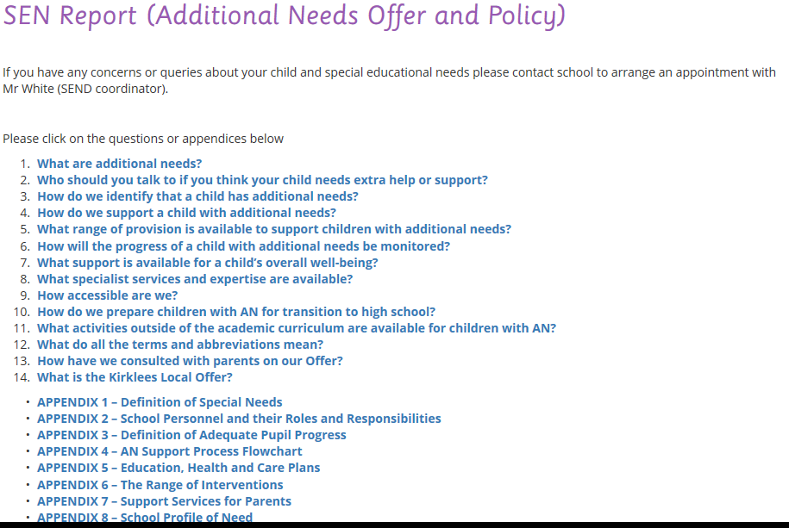

Slide 52
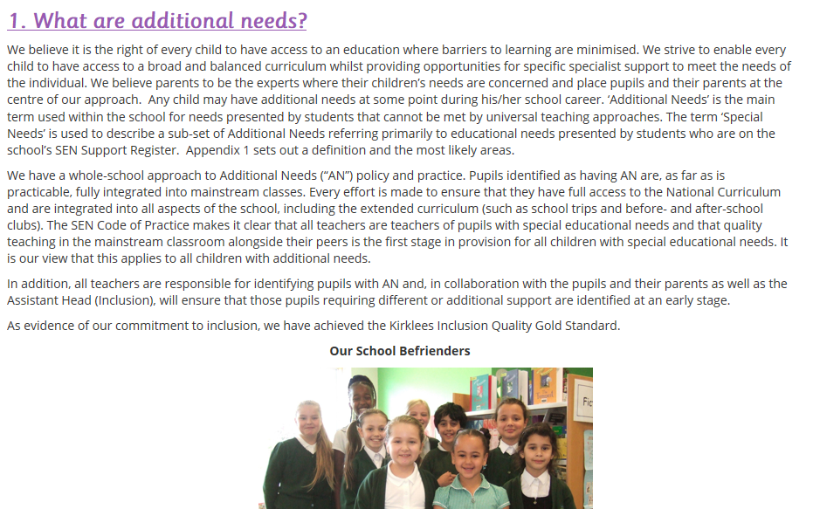

Slide 53
Further guidance is available on SEN docs if needed
http://intranet.kirklees.gov.uk/getattachment/9676bcd7-60a2-4fec-ab87-2cca856cbf71/Special%20educational%20needs%20information%20report%20guidance.aspx

Slide 54
Your SEN Policy
Who is it for?
School staff – a working document to inform practice
LA officers, inspectors, auditors etc. – to provide evidence that school and governors are fulfilling their responsibilities
Parents – to inform and reassure
Pupils – to support their development
Notes:
Christine

Slide 55
SEN Policy and web sites
Guidance from Kirklees available about what should be included: template available on SEN documents
Needs to be updated annually, in conjunction with the school SEN governor
Must be available on the school website, linked to the Kirklees Local Offer, and to parents/staff/governors
Consider:
  Pictures to identify SENCO; clear contact details of SENCO and key people for SEN within school
  Links to relevant agencies
  What to do if anyone has concerns about a child
  Resources to help at home
www.gov.uk/guidance/what-maintained-schools-must-publish-online
Notes:
Christine

Slide 56
Homework
What do we mean by The Golden Thread?
(A knotty question)
Notes:
Christine - Any questions?

Slide 57

If you’re still awake, thank you…….
and see you for Session 2 next time
Notes:
Christine

