Slide 1

Welcome to SENCoNet
Summer 2026
9:00 – 11:30

Slide 2
Time slot | Item | Delivery
8:45 – 9:00 | Networking
9:00 – 9:05 | Bulletin Board | Sarah Grant
9:05 – 9:25 | Portage training | Sharon Jagger
9:25 – 9:45 | ELKLAN | Dr Charlotte Renton
9:45 – 10:00 | EHCP team updates | Rachael Robertshaw
10:00 – 10:15 | Break
10:15 – 10:45 | West Yorkshire Neurodevelopment Support Service WYNESS | Jo Rhodes - Barnados
10:45 – 11:30 | Cluster updates | Anna Garfitt and Oluchi Yusuf

Slide 3

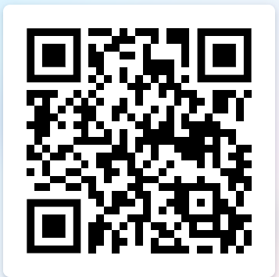
Level 2 or Level 3 Accreditation
New Cohort September 2026 (15 learners)
When
Course will be running bi-weekly from
15th September 2026 – 9th February 2027 (Tuesdays) 1.00pm-3.00pm.
Where
Batley Town Hall, Market Place, Batley, West Yorkshire England, WF17 5DA
Cost £400.00 per learner.
Deadline for booking
Tuesday 1st September 2026
for More information contact:
nicola.shaw@kirklees.gov.uk

Slide 4
Sessions Overview
1. What is communication?
2. Communication Friendly Settings, Adult-child interaction and working with families
3. Listening, looking and understanding spoken language
4. Promoting the development of vocabulary
5. Modifying adults’ speech to help a child understand language
6. The Blank Language Scheme (or Language for Thinking)
7. The language journey - Developing expressive language skills
8. Play for language
9. Supporting children with unclear speech and developing phonological awareness skills
10. Management of stammering, sharing information with parents and course reflection

Slide 5

Portage Workshop
Portage Workshop
What it is and how it can help mainstream settings
Sharon Jagger – EYSEND Strand lead and NPA Accredited Trainer
Notes:
PERFORMANCE OF PRESENTERS: Total time 90 minutes
Explain what Portage is and provide information on its effectiveness
Explain and illustrate the Portage model and principles and how they are incorporated in the work of Early Years settings
Discuss the importance and value of working in partnership with parents
Explain the National Context and current reforms in relation to Portage
Provide information on the National Portage Association
Welcome
To welcome participants
To introduce trainers
To go through “housekeeping” elements (toilets / fire procedures etc.)
Trainers may want to have own specific PPs for housekeeping
Icebreakers & ground rules
To introduce participants to each other
To set the scene regarding open discussion etc. in the workshop
Presenters may want to use icebreaker activities of their own here
Main points of ground rules, using the name cards with the ground rules one side, or could be put up on a flip chart.

Slide 6
What is Portage?
Portage is a teaching and learning model designed to help children with developmental delay / additional needs, learn new skills by breaking them down into very small steps.
It’s a model that has been used internationally for over 50 years and has been an offer in Kirklees for almost as long
Originally designed as a model that was delivered in the home through a home visiting approach – the principles and practice are now widely recognised to be beneficial within educational settings.
Kirklees EYSEND outreach is built on the 12 Portage principles and all practitioners within the service are Portage trained. We also still operate a Portage Home Visiting offer and have 4 Home Visitors in the team.
Over the last 4 years we have expanded the delivery of workshops significantly with colleagues in EY and KS1 provision now accessing the training

Slide 7
partnership
generalising skills
celebrating success
inclusion
celebrating diversity
small steps
PORTAGE PRINCIPLES
enabling
being positive
supporting
looking forward
whole child, family and community
practical, immediate, relevant

Slide 8
What is the Portage Workshop?
The workshop is delivered over 2 days plus a half day follow up
6 – 8 weeks later
It is a fully accredited course, and you receive an NPA linked certificate on completion
Current costs are £100 per person, or arrangements can be made for training through clusters
Maximum of 24 people per workshop

Slide 9
What difference can it make? Impact from Norrishthorpe J & I
We were fortunate to access the EYSEND Portage workshop through Cluster Funding. The sessions were enjoyable and very informative. There was a good mixture of sharing of information, hands on tasks and opportunities to share practice and engage in discussions and network with colleagues from other settings. We found the training beneficial and it gave us lots of ideas on how to improve our practice.
After attending the EYSEND Portage workshop, we began implementing several strategies based on the portage principles and other key learning.
Notes:
Looking forward
Childhood is the foundation on which children build the rest of their lives. It’s not just preparation for the next stage, it’s important in itself
Being positive
All children are able to learn. Building on strengths and abilities rather than focusing on difficulties best supports progress. Success comes in can and not cant’s.
Being positive and realistic about what we are trying to achieve.
Celebrating Success
Each success builds on the next and the child and family will then want to try new activities so making progress.
Small steps
Learning is better achieved when its broken down into smaller achievable steps, this approach can be applies through out the child’s/families life.

Slide 10
Who benefits from the Portage model of working?
The Portage model of working can benefit children who are Woking below age typical development in the early years and early key stage 1
The model aligns with the Cognitive Learning Strategy( CLS) principles – it’s a good step before, for age / stage appropriate children
All staff can benefit – the ‘ gems’ of knowledge around using clear language as opposed to cloudy language, task analysis and using a specific approach to support target setting are transferable to all practice
All families can benefit from the approach – partnership working and ensuring consistency for the child in all contexts is key
Notes:
Looking forward
Childhood is the foundation on which children build the rest of their lives. It’s not just preparation for the next stage, it’s important in itself
Being positive
All children are able to learn. Building on strengths and abilities rather than focusing on difficulties best supports progress. Success comes in can and not cant’s.
Being positive and realistic about what we are trying to achieve.
Celebrating Success
Each success builds on the next and the child and family will then want to try new activities so making progress.
Small steps
Learning is better achieved when its broken down into smaller achievable steps, this approach can be applies through out the child’s/families life.

Slide 11
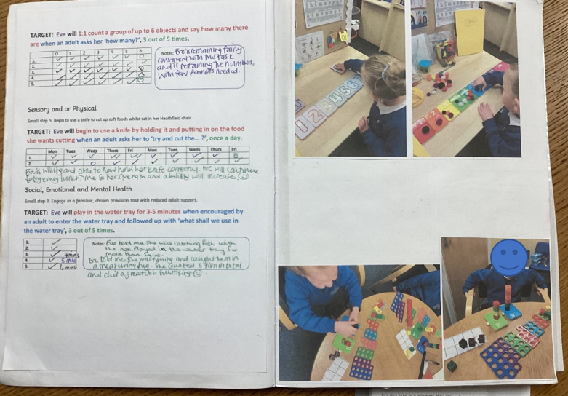
Introduced bespoke learning books for pupils with the most significant needs , focusing on small step targets
Notes:
Looking forward
Childhood is the foundation on which children build the rest of their lives. It’s not just preparation for the next stage, it’s important in itself
Being positive
All children are able to learn. Building on strengths and abilities rather than focusing on difficulties best supports progress. Success comes in can and not cant’s.
Being positive and realistic about what we are trying to achieve.
Celebrating Success
Each success builds on the next and the child and family will then want to try new activities so making progress.
Small steps
Learning is better achieved when its broken down into smaller achievable steps, this approach can be applies through out the child’s/families life.

Slide 12
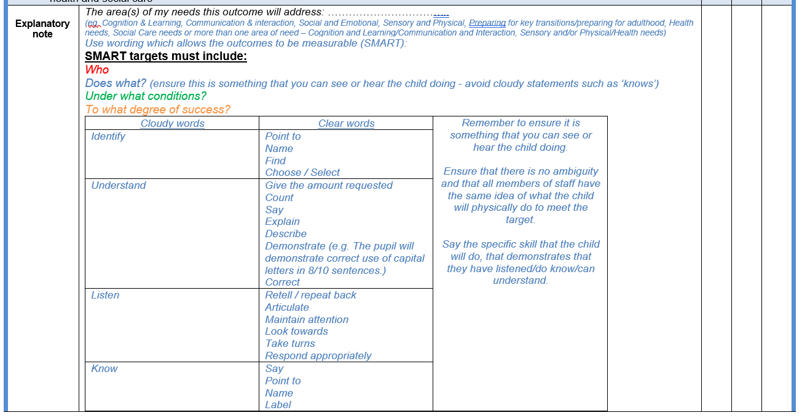
Altered the way targets are written
Notes:
Looking forward
Childhood is the foundation on which children build the rest of their lives. It’s not just preparation for the next stage, it’s important in itself
Being positive
All children are able to learn. Building on strengths and abilities rather than focusing on difficulties best supports progress. Success comes in can and not cant’s.
Being positive and realistic about what we are trying to achieve.
Celebrating Success
Each success builds on the next and the child and family will then want to try new activities so making progress.
Small steps
Learning is better achieved when its broken down into smaller achievable steps, this approach can be applies through out the child’s/families life.

Slide 13
Introduced bespoke learning books for pupils with the most significant needs , focusing on small step targets
Notes:
Looking forward
Childhood is the foundation on which children build the rest of their lives. It’s not just preparation for the next stage, it’s important in itself
Being positive
All children are able to learn. Building on strengths and abilities rather than focusing on difficulties best supports progress. Success comes in can and not cant’s.
Being positive and realistic about what we are trying to achieve.
Celebrating Success
Each success builds on the next and the child and family will then want to try new activities so making progress.
Small steps
Learning is better achieved when its broken down into smaller achievable steps, this approach can be applies through out the child’s/families life.

Slide 14
Impact:
The new small step targets have made things more achievable and we are seeing more success for the children. It is helping us to track the progress of the children more accurately and to ensure that they make progress, no matter how ‘small’.
Using the 4 key questions for these targets makes it very clear for all staff working with them what is expected and under what conditions. This has helped as it can often be different staff working with the children.
Notes:
Looking forward
Childhood is the foundation on which children build the rest of their lives. It’s not just preparation for the next stage, it’s important in itself
Being positive
All children are able to learn. Building on strengths and abilities rather than focusing on difficulties best supports progress. Success comes in can and not cant’s.
Being positive and realistic about what we are trying to achieve.
Celebrating Success
Each success builds on the next and the child and family will then want to try new activities so making progress.
Small steps
Learning is better achieved when its broken down into smaller achievable steps, this approach can be applies through out the child’s/families life.

Slide 15
Adapting some areas of our Reception class to make it more accessible and inclusive
We have introduced some of the resources (such as attention games etc.) that were shared at the training into our reception setting. We have also added more visuals, symbols and made the area more accessible as well as using more neutral colours.
We still have lots more that we are planning to do including updating all plans as they are reviewed to reflect the SMART targets, further work on schemas and using bubble planning to help extend children’s play and further development of our Reception and Year One setting.
Notes:
Looking forward
Childhood is the foundation on which children build the rest of their lives. It’s not just preparation for the next stage, it’s important in itself
Being positive
All children are able to learn. Building on strengths and abilities rather than focusing on difficulties best supports progress. Success comes in can and not cant’s.
Being positive and realistic about what we are trying to achieve.
Celebrating Success
Each success builds on the next and the child and family will then want to try new activities so making progress.
Small steps
Learning is better achieved when its broken down into smaller achievable steps, this approach can be applies through out the child’s/families life.

Slide 16
Accessing through Clusters – feedback
Cluster 4 & 11 - Victoria Shackleton
Cluster 6 – Sarah Wensley
Notes:
Looking forward
Childhood is the foundation on which children build the rest of their lives. It’s not just preparation for the next stage, it’s important in itself
Being positive
All children are able to learn. Building on strengths and abilities rather than focusing on difficulties best supports progress. Success comes in can and not cant’s.
Being positive and realistic about what we are trying to achieve.
Celebrating Success
Each success builds on the next and the child and family will then want to try new activities so making progress.
Small steps
Learning is better achieved when its broken down into smaller achievable steps, this approach can be applies through out the child’s/families life.

Slide 17

How to book.
Portage Workshop for Schools:
Central Booking
Autumn Term Dates:
Tuesday September 22nd 9.15 – 3.30
Thursday September 24th 9.15- 3.30
Tuesday November 3rd 9.30 – 12.00
£100 pp
Denby Dale First and Nursery School
https://kirkleesbusinesssolutions.uk/Event/301844
Dewsbury.psychology@kirklees.gov.uk
01924 483744
Cluster bookings- please raise through your cluster discussions
Notes:
Looking forward
Childhood is the foundation on which children build the rest of their lives. It’s not just preparation for the next stage, it’s important in itself
Being positive
All children are able to learn. Building on strengths and abilities rather than focusing on difficulties best supports progress. Success comes in can and not cant’s.
Being positive and realistic about what we are trying to achieve.
Celebrating Success
Each success builds on the next and the child and family will then want to try new activities so making progress.
Small steps
Learning is better achieved when its broken down into smaller achievable steps, this approach can be applies through out the child’s/families life.

Slide 18
Final words…….
All staff should do this training , it’s fantastic and so worthwhile
Cluster 6 & 2 colleague – January 26
Notes:
Looking forward
Childhood is the foundation on which children build the rest of their lives. It’s not just preparation for the next stage, it’s important in itself
Being positive
All children are able to learn. Building on strengths and abilities rather than focusing on difficulties best supports progress. Success comes in can and not cant’s.
Being positive and realistic about what we are trying to achieve.
Celebrating Success
Each success builds on the next and the child and family will then want to try new activities so making progress.
Small steps
Learning is better achieved when its broken down into smaller achievable steps, this approach can be applies through out the child’s/families life.

Slide 19
Overview of ELKLAN
By Dr Charlotte Renton
Educational Psychologist
Primary ELKLAN tutor

Slide 20
Session aims
By the end of the session you will:
  Be familiar with the structure of the two courses
  Understand what you can expected from ELKLAN
  Understand what is expected of learners
  Know the time commitment required
Notes:
Read through slides

Slide 21
What is ELKLAN
Created by two Speech and Language Therapists Henrietta McLachlan and Liz Elks in 1998.
Focus on empowering school staff with the knowledge and practical strategies to utilise speech and language therapy methods in the classroom to develop children’s communication skills.
Notes:
Elklan provides effective and accessible training to ensure everyone in a child’s network can support the development of children's speech, language and communication.
Elklan delivers courses to teachers, teaching assistants, early years practitioners and parents, empowering them with the knowledge and practical strategies to utilise speech and language therapy methods in the classroom to develop children’s communication skills.
Elklan’s main offer is a range of core speech and language support courses. The core courses will equip practitioners with strategies to support language and communication development in the classroom and recognise and address SLCN.

Slide 22
Courses and Tutors
Speech and Language Support for 5-11s
(delivered by Dr Charlotte Renton and Dr Taylor Stone)
Speech and Language Support for 11-16s
(delivered by Dr Charlotte Harte)
Notes:
There are two courses within the offer – one focussed on supporting 5-11 year olds (primary) and one supporting 11-16 year olds (secondary).
The primary courses are delivered by either Dr Charlotte Renton at Huddersfield Town Hall or Dr Taylor Stone at Batley Town Hall
The secondary courses are delivered by Dr Charlotte Harte- one at Batley Town Hall and one later in the year at Huddersfield Town Hall

Slide 23
Course overview
10 interactive sessions
Accredited to level 2 or 3 – in order to gain accreditation, learners must attend at least 8 sessions and complete/pass 100% of the learning log. Learners get up to 3 attempts to pass each task.
The development of speech, language, communication and associated skills
Practical advice and strategies to support the children/young people you work with
Language Builders book (with all the key content from the sessions)
Access to the learner’s area of the website
Notes:
Read through slide

Slide 24
Primary sessions
1. What is involved in communication?
2. Non-verbal communication and adult-child interaction
3. Social communication skills
4. Listening and attention skills, understanding spoken language
5. Memory and independent learning
6. Helping children to understand abstract language
7. Promoting vocabulary development
8. Developing expressive language and narrative skills
9. Supporting children with unclear speech and the link between speech, language and literacy
10. Helping children who stammer and linking it all together
Notes:
Read through slide

Slide 25
Secondary sessions
1. What is involved in communication?
2. Interaction, Listening and Attention
3. Memory and Learning
4. Memory and Understanding Spoken Language
5. Developing Verbal Reasoning and The Blank Language Scheme
6. Promoting Vocabulary Development
7. Supporting Expressive Language and Narrative Skills
8. The link between Speech, Language and Literacy
9. Supporting Social and Emotional Literacy
10. Linking it all together
Notes:
Read through slide

Slide 26
Time commitment per session
Face-to-face session (2 hours)
Reading the relevant chapter in the Language Builders book (half an hour)
Planning and carrying out practical tasks for the learning log (1 hour)
Writing up the learning log answers (1 hour).
Note: learning logs should be submitted within a week of the session to allow time for marking before the next session
Notes:
Read through slide
Expectations- bottom point really important so that people don’t get behind
Also expectation that level 2 or level 3 is completed and that schools know when they sign someone up, that they need to allow the time for the learning logs to be completed.

Slide 27
Overview
Receive registration details from tutor
Register on the ELKLAN website to access information and Learning Log
Attend Session 1
Plan and implement learnt knowledge and strategies in your setting
And
Write up learning log
Check learning log and complete amendments
Repeat for sessions 2-10
Notes:
Read through slide

Slide 28
The benefits of completing an ELKLAN course
Whole setting
Family
Practitioner
Child/young person
Notes:
Knowledge gained during the course supports not only the child and the practitioner completing the course, but the whole school setting and families.

Slide 29
What do other learners think?
The ELKLAN training has been invaluable, and we would recommend it to other secondary schools thinking of doing the training. It has opened my eyes to the difficulties faced by students with language barriers across the curriculum.
(Secondary course currently)
Notes:
Read through slide
Weve had a mix of teaching assistants and SENCOs on the course.

Slide 30
What do other learners think?
Elkan has been a fantastic course for me . It has extended my knowledge of speech and language and given me strategies to help pupils who struggle with SCLN. The course work has helped me to cement my knowledge and try out various activities with children to further my professional development.
I would definitely recommend it to others
(primary)
Notes:
Read through slide

Slide 31
What do other learners think?
I have found it really interesting and have gotten a real sense of how our children with SLCN feel through some of the activities we have done. You have shown me how I can make my S&L interventions, with the children I support, interesting and how I don't have to be using lots of worksheets. I have already shared some of my knowledge with my work colleagues so that together we can better support our children plus I am using lots of the strategies that we have looked at in my everyday practice.
(Primary)
Notes:
Read through slide

Slide 32
What do other learners think?
The course has been really informative and has helped to develop my understanding of a range of Speech, Language and Communication Needs that children may experience. The course has provided lots of practical, useful strategies that can be easily implemented within the classroom, not only for those children with SLCN, but for the benefit of all pupils. As a SENDCO, completing the course means that I am now in a better position to be able to support and advise colleagues in how they can support pupils within their own classes, especially when waiting lists for Speech and Language assessment/involvement are so long.
Notes:
Read through slide

Slide 33
What do other learners think?
Hear from Penny Kingston – Honley Junior School

Slide 34
Any questions?
Please don’t hesitate to email: charlotte.renton@kirklees.gov.uk (primary) taylor.stone@kirklees.gov.uk (primary) charlotte.harte@kirklees.gov.uk (secondary)
Notes:
Read through slide

Slide 35
Kirklees Overview
500 Ongoing EHC Needs Assessments
  Bottle neck in EHC Needs Assessments which is leading to delays in decisions on whether to issue.
5115 Active EHCPs
  Backlog in allocation of Annual Reviews.
Notes:
22 Caseworkers to process all of the above.

Slide 36

EHC Needs Assessment Context
Nationally and locally we are seeing on average 12% increases year on year in request for EHC Needs Assessments. Last year alone Kirklees processed 1,114 requests for assessment
All EHC needs Assessments require Multi-Agency Specialist Advice and there is a national shortage of specialist advice givers, particularly EPs, SALT and Health. Without specialist advice, it is not possible to make fully informed decisions. Each piece of advice requires substantial professional time to assess the child/young person’s needs, analyse their findings and the evidence and produce a detailed report.
Notes:
And we are already up 8% on last years figures and we are only 3months into this current year! To go with the 12% increase paragraph.
It is also important to note that our Specialist Advice Givers do not work in silos which adds to complexity created by the shortages and the backlog that can be seen within the “Assessment & Information Gathering Stage”. To go with the advice givers paragraph.

Slide 37
EHC Plans by School Phase Breakdown
5144 Active 2433 North 2803 South
Tribunals & Mediations
Nursery 48 - 10% have been through a tribunal/mediations
Primary 1890 - 8% have been through tribunal/mediations
Secondary 1686 - 5% have been through tribunals/mediations
Post 16 1520 – 5% have been through tribunals/mediations

Slide 38
EHC Plans Overview
5144 Active EHCPs
2433 North (13% Increase) 2803 South (9% Increase)
On average the number of EHCPs are increasing by 7% each month.
Based on current figures by April 2027 Kirklees will have over 5500 Active EHCPs

Slide 39
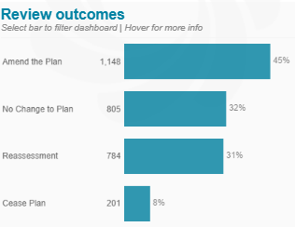
Annual Reviews
2938 Annual Reviews have been completed/are in the process of being completed in the last 12 Months the outcome of those reviews were as follows:
We have 1001 young people identified for Change of Phase 2027 – please would you support by holding your annual reviews in the first term.

Slide 40


West Yorkshire Neurodevelopmental Early Support Service (WYNESS)

Slide 41

West Yorkshire Neurodevelopmental Early Support Service (WYNESS) launch
Barnardo’s delivered Neurodevelopmental Family Navigator Service (NDFNS: August 2023 –
March 2026) and Neurodevelopmental Connections Service (March 2025 – March 2026).
West Yorkshire ICB ambition has been to develop an amalgamated needs-led early support service which takes the learning and offers neurodevelopmental early support to children, young people and families. The Service focuses on strengthening parental confidence, reducing stress and anxiety, and supporting children and young people to remain engaged in education, community life and universal services while awaiting assessment or adjusting to a new neurodevelopmental diagnosis.
Mobilisation of Service 01st April 2026. Soft launch on Monday 20th April 2026. The Service will have:
Family Impact: strengthening parental confidence, reducing stress, and clearer understanding of children’s neurodevelopmental needs
Child & Young Person Impact: improve emotional regulation, wellbeing, and engagement with education and community.
System Impact: reduce escalation into specialist or crisis services through early, targeted support.

Slide 42
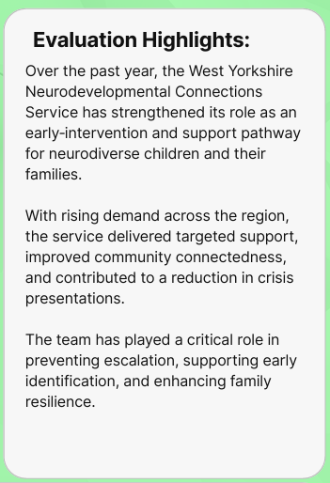
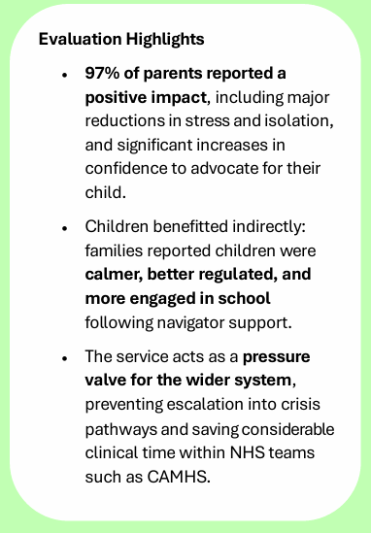
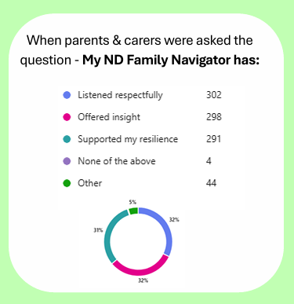
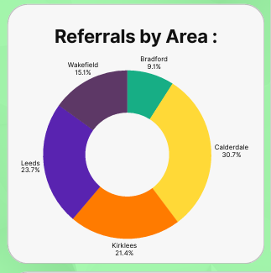

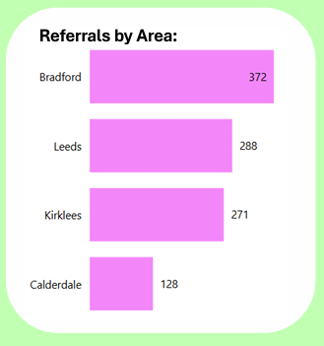
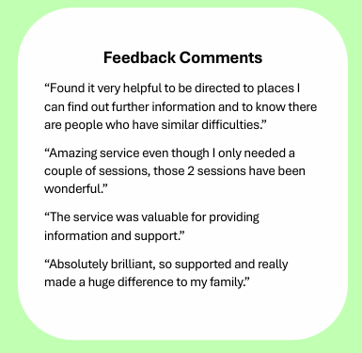
Family Navigator Service and Connections Service
Theme | Child/Young Person Needs across West Yorkshire
Emotional Regulation & Mental Health | Emotional regulation, anxiety, low self-esteem, depression, EBSA, risk perception
Education & Support in School | EHCP challenges, SENDCO gaps, adjustments, masking at school, support plans
Family Dynamics & Relationships | Parent-child communication, sibling relationships, young carers, work with fathers
Transitions | Primary-to-secondary transitions, broader educational stage transitions
Behaviour & Coping at Home | Behavioural challenges, demand avoidance, sensory needs
Sleep & Daily Routines | Sleep difficulties, switching off, interoception affecting continence
Eating & Sensory Needs | Eating difficulties, ARFID, sensory sensitivities
Self-Advocacy & Rights | Child/YP self-advocacy, parents needing advocacy with schools
Understanding of Neurodiversity | Autism/ADHD awareness, undiagnosed siblings, parental self-diagnosis

Slide 43
West Yorkshire Neurodevelopmental Early Support Service (WYNESS)
West Yorkshire Integrated Board have commissioned West Yorkshire Neurodevelopmental
Early Support Service (WYNESS).
Service delivery: Early, non-clinical support to families of children and young people (up to age 18) awaiting ADHD and or autism neurodevelopmental assessment or recent diagnosis of autism and/or ADHD. Operating across Bradford, Calderdale, Leeds, Kirklees and Wakefield, the service responds to prolonged diagnostic waiting times and child/young person post-diagnostic adjustment needs that increase the risk of family distress, escalation of need and pressure on specialist and statutory services.
The service delivers a consistent single point of access across West Yorkshire, offering structured triage and a graduated model of support aligned with needs-led early support principles, the SEND Code of Practice and NHS Waiting Well priorities.
Through timely engagement, practical guidance and clear system navigation, WYNESS aims to prevent escalation to higher-cost statutory or clinical interventions. Referrals are accepted from professionals in CAMHS, SENDCos, Neurodevelopmental Assessment Teams and GP Practices.

Slide 44
WYNESS criteria
Professional referrals are accepted from:
Designated School Special Educational Needs and Disabilities Coordinator (SENDCo)
Child and Adolescent Mental Health Service
Neurodevelopmental Assessment Team
General Practitioners (GPs)
WYNESS is available to parents/carers where:
the child or young person is aged up to 18 years (Referral accepted up to 17.5 years)
a child or young person is on a neurodevelopmental diagnostic waiting pathway for ADHD and/or autism, or
has received an ADHD and/or autism diagnosis with in last 6 months; and
the family is resident within Bradford, Calderdale, Kirklees, Leeds or Wakefield.
WYNESS is available to children and young people where:
the child or young person is aged up to 18 years (Referral accept up to 17.5 years)
a child or young person has received an ADHD and/or Autism diagnosis within last 6 months; and
the family is resident within Bradford, Calderdale, Kirklees, Leeds or Wakefield.

Slide 45
WYNESS exclusion criteria
WYNESS does not provide support where:
Support is already being provided, or should be provided, by another service with a statutory duty of care or legal responsibility.
There are immediate safeguarding concerns that require statutory social care intervention.
A child or young person is experiencing an acute mental health crisis that requires an urgent clinical response. The family is already receiving intensive statutory or specialist intervention, and WYNESS involvement would duplicate existing support.

Slide 46
Our stakeholders
Internal team
Direct Delivery Team: WYNESS Practitioners X10 (8.5 FTE)
Leadership: Programme Manager, Statutory Health Lead, Children’s Services Manager, 2 Team Managers (1.7 FTE)
External stakeholders
Our professional referrers: CAMHS, Neurodevelopmental Assessment Teams, School SENDCos, GPs
Support at Place to embed the Service – through Local Offer/Place based education and health service providers
System partners across West Yorkshire to share developments and learning from the Service
Direct delivery of support to children, young people, parents/carers and their families

Slide 47
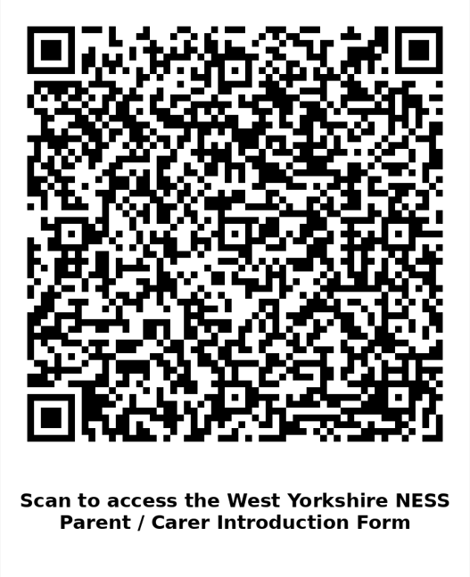
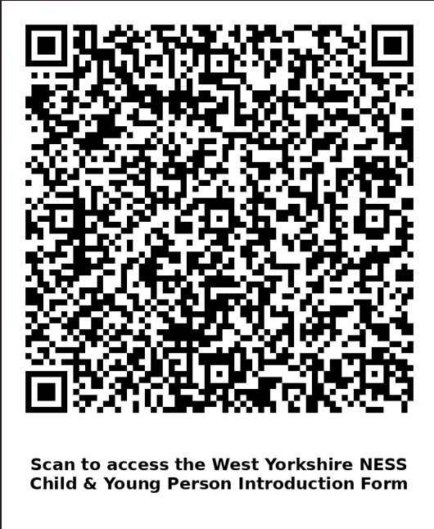
Key documentation for professional referrals
West Yorkshire NESS Child/Young Person Introduction Form
West Yorkshire NESS Parent/Carer Introduction Form
Consent documentation (digital) will be sent to the service user to complete when triage is booked in.
Microsite: West Yorkshire Neurodevelopmental Early Support Service | Barnardo’s
QR Codes:

Slide 48
The Service Offer – how does it work
Initial triage:
All families have triage to understand family/CYP needs and identification of the pathway of intervention
and support required. Action plan developed.
Pathway 1 / Pathway 1+:
Digital Connection Support: allocated worker provides accessible early information, advice and guidance. Targeted signposting and sharing of local knowledge of services and resources (includes Healthier Together website) The offer will also include online workshops. Pathway 1+ includes follow up call to review support needs and review/closure if needs are met.
Pathway 2:
Navigation Support: for moderate need or emerging risk. The intervention has an allocated worker delivering time-limited (up to 6 weeks), structured and relational support for parents and carers focusing on 2-3 priority areas.
Pathway 3:
Targeted Young People Support: For children and young people who have an ADHD and/or autism diagnosis with higher needs. An allocated worker delivered targeted face to face/online support (up to 6 weeks) supporting self- identity and understanding of diagnosis and building confidence, resilience and emotional wellbeing.

Slide 49


Understanding our pathways
Keyworker
Triage
01
1+
02
03
Agreed step down for support to families and CYP post Keyworker Support
Score and scaled telephone triage
Pathway 1
Pathway 1 +
Family Allocated
Pathway 3
Allocated worker - Signposting, workshops, peer support, digital resources. This can be done on the call if staff feel they can direct the family and provide all the appropriate support
As Pathway 1 - with an agreed callback within 4 weeks to check on progress
Time-limited allocated worker.
Before allocating a worker, staff must have conversation with a manager and be able to justify why this level of support will is needed.
Child/young person pathway support
Level 1: Allocated worker support
Level 2: LEE/Digital Offer (to be developed)
Early Support Worker
Will work across ALL places, will triage, will case-hold and will support CYP.
Delivery over the phone, online and face to face

Slide 50

Pathways 1 and 1+ – For lower to moderate levels of need
Who this is for:
Families whose needs are identified through the triage tool as present but manageable with information, guidance and peer-based support.
Delivered through:
Targeted signposting
sharing local knowledge of services/resources (including the digital offer on WY Healthier Together website)
online workshops
peer support
a follow up within a month to review circumstances to then be closed to the Service.
Feedback sought.

Slide 51

Pathway 2 – For moderate need or emerging risk
Who this is for:
Families identified through triage as having emerging or escalating needs that require structured, relational support but do not meet statutory thresholds.
Delivered through:
Allocated named worker, providing focused support to parent/carer
Time-limited intervention of up to 6 weeks reviewed at 4 weeks
Clear, agreed outcomes, typically focused on 2–3 priority areas.
Once achieved the support will close.
Structured review at closure and feedback sought.

Slide 52

Pathway 3 - Eligibility
Children and young people who have an Autism/ADHD diagnosis. (Diagnosis within previous 6 months)
A specific need supporting wellbeing with the CYP around their new diagnosis.
Who this is for:
For children and young people with higher or more complex needs
A named member of staff provides targeted face to face/online support for a time-limited period of up to 6 weeks.
Focused on delivering:
Supporting self-identity and understanding following a neurodevelopmental diagnosis.
Building confidence, resilience and emotional wellbeing; and
Facilitating engagement with longer-term universal or community-based support (e.g. youth services, short breaks, community activities).
LEE/Digital Offer (to be developed from September 2026 by Youth Ambassadors)
The aim is to embed sustainable support and reduce reliance on specialist or crisis services.

Slide 53
Stakeholders' communication needs
External – System Wide West Yorkshire Partners
Referrers Include: ND Assessment Teams, CAMHS, School SENDCos, GPs
(professional referrals only)
Service Users Include: Families and children and young people accessing support
Needs:
Clear referral pathways
Criteria for navigation and targeted support
Expected turnaround and communication points
Insight into service impact and outcomes
Opportunity to feedback on the experience of service
Format:
Digital guidance and referral forms
Referral feedback loops
Quarterly updates

Slide 54
Our outcomes
Family Impact
Increased parental confidence
Reduced stress and anxiety
Clearer understanding of neurodevelopmental needs
Early support prevents later escalation
Young Person Impact
Better emotional regulation
Improved wellbeing
Sustained education and community involvement
System Impact
Lower demand on specialist services
Reduced crisis presentations
Stronger early identification and intervention pathways

Slide 55
Roles and responsibilities
Role | Responsibility
Team Managers | Operational responsibility and oversight; oversee updates, line management of staff team
WYNESS Staff Team (Early Support Workers) | Direct delivery, provide case updates, record data, contribute to triage, maintain outcomes
Programme Manager and Statutory Health Lead | Liaise with system partners, escalate issues, review data trends
System and Place-Based Leadership | Monitor service impact, provide strategic oversight, and support decisions
Professional referrers and Children, Young People, Parents and Carers | Provide accurate referral information, engage with feedback mechanisms

Slide 56
Escalation process
Step 1: Issue identified by practitioner/ WYNESS Team
Step 2: Manager reviews severity and guidance.
Step 3: Escalate to Programme Manager where needed.
Step 4: Leadership escalation within 24 hours if critical.
Step 5: Leadership determines response and communicates next steps
Step 6: Risks, performance updates & outcome summaries (information to feedback to system partners, place-based commissioners and MHLDA Partnership Board)
Please note the escalation process will align to Barnardo's policies and procedures

Slide 57
Mobilisation
Dates | Actions
01st – 17th April 2026 | Staffing confirmed, team management in place, mapping of local services undertaken by team and administrative, data management and processes developed. Testing of data capturing templates completed.
20th-21st April 2026 | Service Go Live date Soft launch – Bradford: accepting referrals/testing referral pathways Internal referrals open for West Yorkshire Keyworker Service for children and young people in ‘stepdown’ of Keyworker support. Launch email sent to Place Commissioners in Calderdale, Kirklees, Leeds and Wakefield.
4th May 2026 | Complete Local Offer information for WYNESS across Bradford, Calderdale, Kirklees, Leeds, Wakefield, and ensure information is accessible. Aim to have Service delivering in Leeds, Wakefield, Calderdale and Kirklees.
May 2026 | Wider health, education and primary care network engagement and promotion
June 2026 | Report back to System and Place-based leadership

Slide 58

Cluster Communities
SENDCoNet - Thursday 25th June

Slide 59


Slide 60











Cluster 9

Slide 61
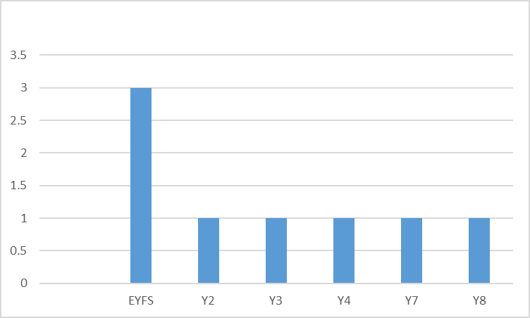
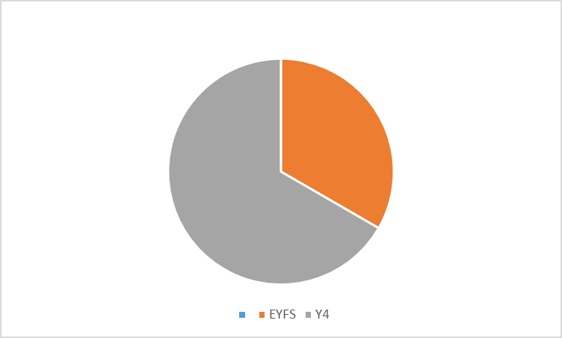
Cluster 9
Overview of cases:
8 individual
3 group (1x EYFS, 2xY4)
5 whole cluster

Slide 62
Cluster 9 - Discussion 1
Y3 pupil with EHCP
Part-time timetable (2 hours per day)
Mostly learning outside
1:1 and occasionally alongside 1:3
Difficulties accessing mainstream
Physically aggressive towards adults & children
Consuming unsafe/unsanitary non-food substances
Difficulties establishing professional relationship with parents

Slide 63
Discussion 1 – Outcomes of Cluster Recommendations
Home visit to attempt to establish how child engages at home and what home looks like
Planned transition
Locala 0-19 team to identify potential health issues
Seek support via Early Help
Review of EHCP
Adapted curriculum for this pupil based on their preferences
Frequent sensory breaks and increase in available sensory equipment
Key staff in school worked with pupil to increase the number of strategies they could use to regulate

Slide 64
Cluster 9 - Discussion 1
Specific Examples
Part-time timetable (accessing 2 hours per day) Accessing provision alone or alongside 3 other pupils with SEN Challenges working with parents | Accessing school full-time Able to access mainstream class for small amounts of time Improved collaboration with parents
Confidence in being able to meet the needs of the child prior to discussion: 2
Confidence in being able to meet the needs of the child prior to discussion: 7

Slide 65
Cluster 9 - Discussion 2
Y6 pupil with MSP
Previous suspensions for physical violence
Exploitation risks/concerns
Part-time timetable
Attempts to climb out of windows onto roof and over railing
1-1 with him all of the time
Did not open up to anyone
Lack of respect for mum
Given up on learning – no interest in lessons/subjects

Slide 66
Discussion 2 – Outcomes of Cluster Recommendations
Extra transition plans implemented
Discussion around his self-esteem
Interventions for self-esteem, resilience & aspirations
Discovered interest in gardening and physical work where he can see the difference
Daily Maths & English lessons
Bespoke afternoon tasks

Slide 67
Cluster 9 - Discussion 2
Specific Examples
Part-time timetable (accessing 3 hours 20 mins initially) Previous suspensions/ physically aggressive/ verbally abusive/ unsafe behaviours Identified need around self-esteem and resilience | Accessing school full-time Able to access mainstream lessons for half of each school day plus bespoke learning for the remainder of each day Improved regulation
Confidence in being able to meet the needs of the child prior to discussion: 4
Confidence in being able to meet the needs of the child prior to discussion: 7

Slide 68
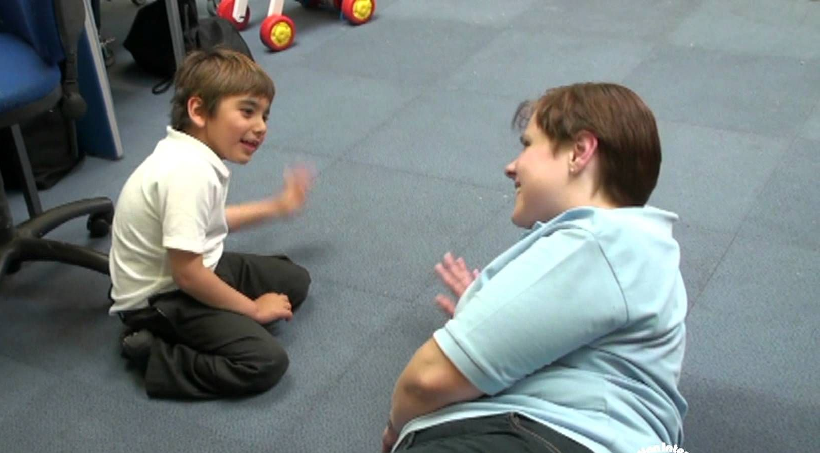


Cluster 9
Cluster-wide training/resources
Intensive Interaction - £1500
(22 staff trained, 41 children across 8 settings impacted)
Lunchtime supervisor AET training - £902
Delivered by CCI & EYSEND
(32 staff trained, 350 children across 4 settings impacted)
Widgit - £2920
(139 staff using, 1932 children across all 11 settings impacted)

Slide 69
Cluster 9
Lots of ideas from a range of professionals.
Positive Impact
Signposting for other support to access for children and parents.
Professional relationships, guidance, support
TAC
Transition
Consistency
Deepening understanding
More preventative and proactive, and less reactive
Learning process/ developing expertise
Having the opportunity to talk with high school SENCOs and building that relationship to aid transition
Access to a range of professionals face-to-face.
Cluster 9 is a really supportive group.

Slide 70

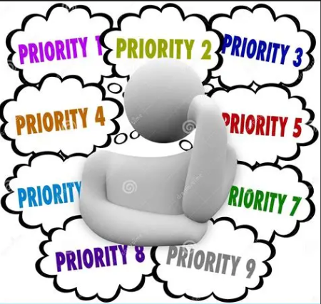
Cluster 9
Challenges
Ensuring efficient use of cluster funds
Key priorities 26-27
Continue to develop a proactive, preventative approach
Consistency of QFT in all school
Keep abreast of updates and latest developments

Slide 71
SENDCo Survey Feedback
‘It helps with things you might not have thought of-you can’t always see things when you are in the middle of it.’
Positive attendance and engagement
Time to unpick
Sharing ideas, knowledge and strategies
Developing consistency of provision
Fresh pair of eyes & alternative viewpoint
Advice from a range of professionals
Training/CPD opportunities
Reassurance or confirmation about choices or next steps
Networking and building relationships
Greater collaboration and strategic thinking
Improved pathways to support
Improved transition between phases
Funding and resources (including ‘exceptional funding’)
Supports SENDCo Wellbeing
‘Talking with a range of professionals to share good practice and ideas to support a child/group of children. It is supportive and non-judgemental.’
Notes:
You get out of it what you put into it.

Slide 72
How much has cluster working impacted positively on your practice?
100% of SENDCos answered that clusters are having a positive impact on their practice (92% in 2025)
Average score 3.6/5 (3.1 in 2025)
Key Impacts
Implementation of new strategies and interventions
Improved staff training and confidence
Greater awareness of services, pathways, and resources
More strategic and reflective SEND practice

Slide 73
How much has cluster working impacted positively on provision for children with SEND in your school?
98% of SENDCos answered that clusters are having a positive impact on children with SEND (90% in 2025)
Average score 3.6/5 (2.9 in 2025)
Evidence of Impact
Improved pupil progress, engagement, and wellbeing
Increased access to targeted interventions
Enhanced speech and language support
Development of SEND provision spaces
Improved early intervention and referrals

Slide 74
Cluster Training & Resources
Some examples of use of funding:
Access to training:
ELKLAN
Intensive Interaction
Makaton
Drawing and Talking
Portage Workshop
Access to resources:
WELCOMM & VERBO
Widget
See and Learn
Sensory resources
IDL
Clicker
Other:
Staff to provide time limited intervention
Therapeutic support
Speech and Language Therapist
Training through Kirklees Offer:
  Supporting Neurodivergent Children
  Circle of Friends
  EBSA
  Positive Guidance
  Cognitive Learning Strategy
  Executive Functioning
  Transition to Year 1
  Play training
  Therapeutic Story Writing
Notes:
Multiple survey to seek an understanding of what is going well, where there are challenges and what improvements need to be made.
Debbie @ Beaumont said last time to focus on what we can do, not what we can't
Some support to allow schools to attend training

Slide 75
Future Aims and Objectives for cluster working?
Greater consistency of Ordinarily Available Provision and Graduated Approach
Consistent focus on understanding CYP needs
Consistent use of solution focused approach
Shared understanding of expectations around reasonable adjustments
A broad range of cluster discussions
Effective use of cluster funding
Continue to develop a shared vision of cluster working and funding allocation
Effective accountability measures for cluster funding
Effective impact measures
Support network for new SENDCos

Slide 76


